Slide 1
Claimant Access to eFolder
Retrieving the mySocialSecurity Message
The Message Center is a secure, convenient portal where you can receive sensitive communications such as your electronic case documents.
You may request a copy of your electronic case documents from the Field Office or Hearing Office where your SSDI or SSI case is pending.
When the office has sent your documents to the Message Center, you will receive a notification based on your my Social Security notification preferences (email or text).
Follow these easy steps to view and download your case documents.

Slide 2
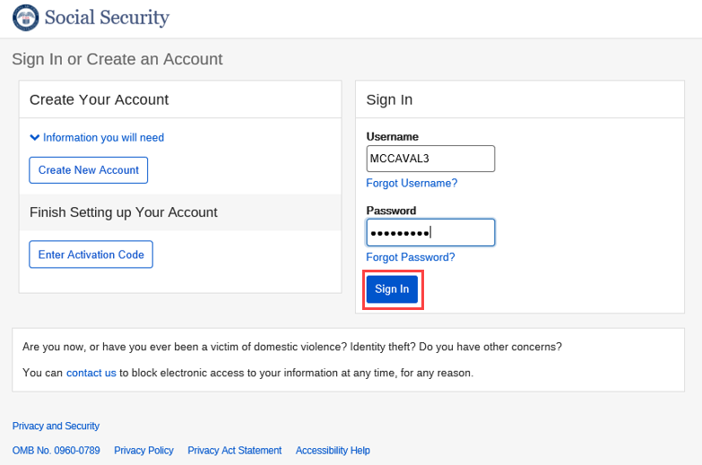
Claimant Access to eFolder
Retrieving the mySocialSecurity Message
Sign into mySocialSecurity

Slide 3
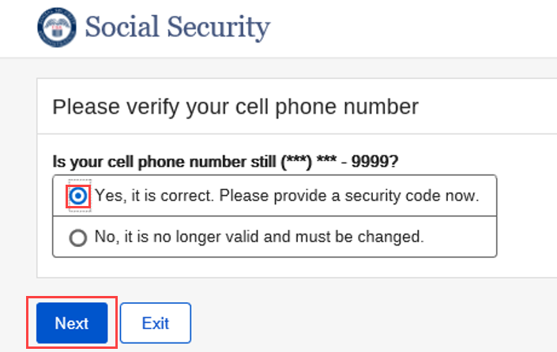
Claimant Access to eFolder
Retrieving the mySocialSecurity Message
Verify cell phone number

Slide 4
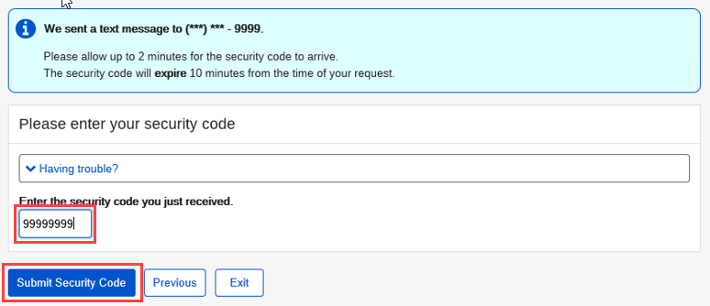
Claimant Access to eFolder
Retrieving the mySocialSecurity Message
Enter the security code from the text message sent to the cell phone

Slide 5
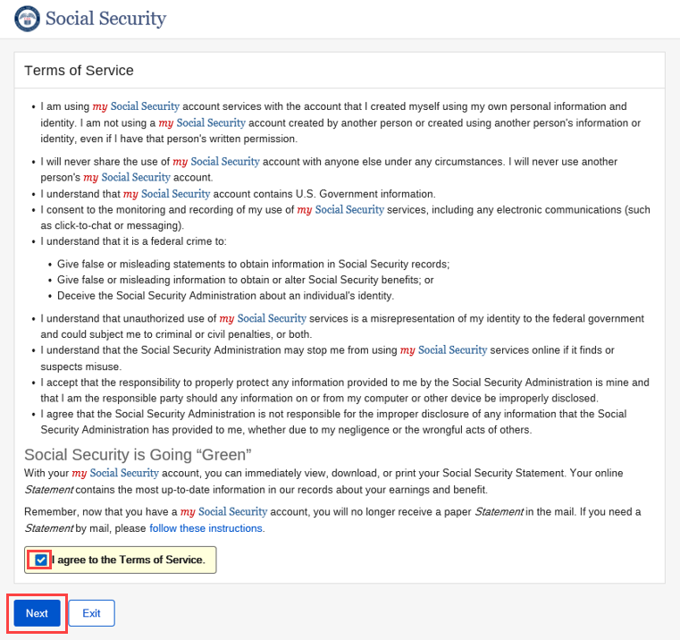
Claimant Access to eFolder
Retrieving the mySocialSecurity Message
Agree to the Terms of Service
Click on “Next”

Slide 6
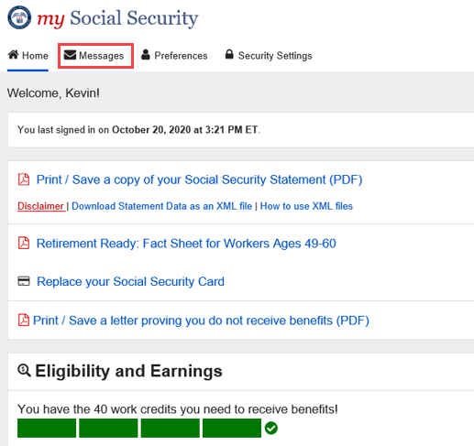
Claimant Access to eFolder
Retrieving the mySocialSecurity Message
Select “Messages”

Slide 7
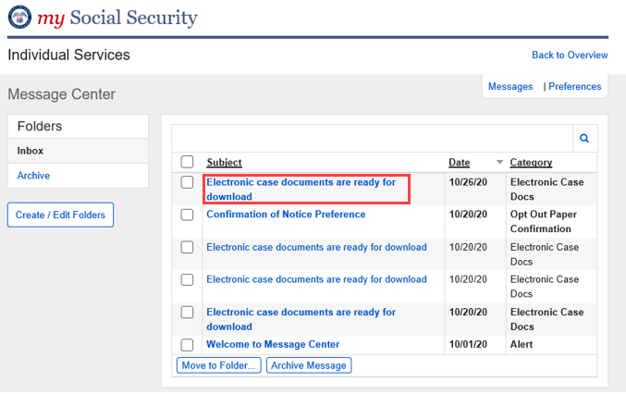
Claimant Access to eFolder
Retrieving the mySocialSecurity Message
Open the message
“Electronic case documents
are ready for download”

Slide 8
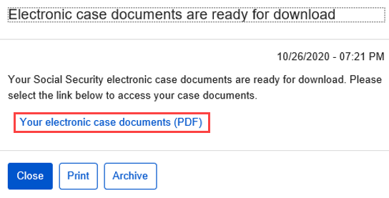
Claimant Access to eFolder
Retrieving the mySocialSecurity Message
Click on the “Your electronic case documents (PDF)” link to view the PDF

