Slide 1



National Slam the Scam Day
#SlamTheScam
MARCH 5, 2026

Slide 2
Help us #SlamTheScam!
On March 5, 2026, help Social Security Administration and the Office of the Inspector General #SlamTheScam for the seventh annual National Slam the Scam Day.
We’re partnering with other government agencies to raise public awareness of government imposter scams that continue to happen nationwide.
Slam the Scam Day is part of the larger National Consumer Protection Week (NCPW), hosted by the Federal Trade Commission March 1 - 7, 2026.
The following slides will help you #SlamTheScam on Facebook and/or LinkedIn during National Consumer Protection Week #NCPW and on National Slam the Scam Day.

Slide 3
#SlamTheScam Facebook / LinkedIn Toolkit
Help protect your community by sharing #SlamTheScam content. Don’t forget to share other #SlamTheScam posts and stories.
Use the blank template and/or ready-to-share templates provided in the following slides. Create your own messages, captions, or use our provided captions for guidance.
Save the template slides as an image and share using the #SlamTheScam hashtag.
Post #SlamTheScam content during National Consumer Protection Week, March 1—7, and beyond!

Slide 4
EXAMPLES

Slide 5

Example 1: Hang up or ignore suspicious calls, texts, or emails
Post: Hang up or ignore suspicious calls or messages. Government employees will NEVER threaten you or demand immediate payment. #SlamTheScam #NCPW2026

Slide 6

Example 2: Report scams to the appropriate agency
Story: If you receive a suspicious call, text, or email that mentions Social Security, ignore it and report it at [link: ssa.gov/scam.] Report other government imposter scams to FTC.gov #SlamTheScam #NCPW2026

Slide 7
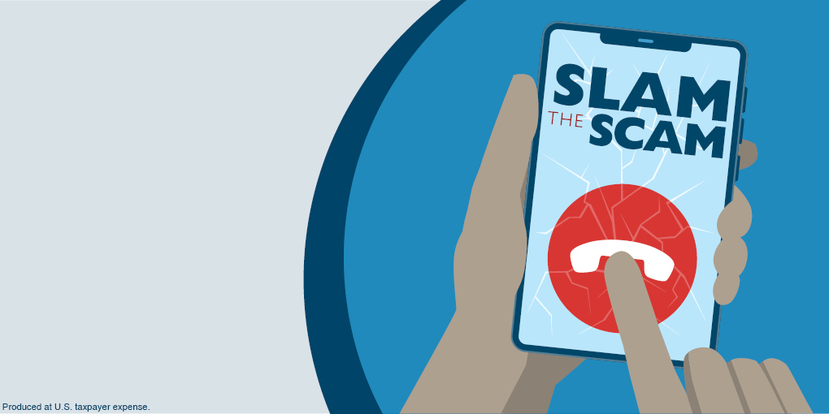
Example 3: Highlight ‘Slam The Scam’ partners and events
Post: Help get the word out about government imposter scams on March 6. Visit [link: ssa.gov/scam] to learn how you can #SlamTheScam #NCPW2026
Protect yourself from scams!
Be on the lookout for fake calls, texts, emails, messages on social media, or letters in the mail.

Slide 8
TEMPLATES

Slide 9
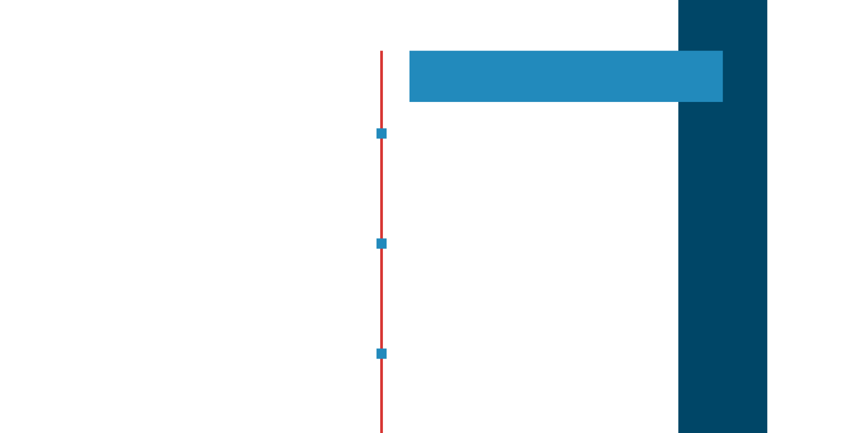
BLANK TEMPLATE
Add your #SlamTheScam message to the template.
Use the picture icon to add your agency’s logo to the template.
Add hashtags such as #SlamTheScam, #NCPW2026, and #NCPW to your caption.

Slide 10
  Click on the specific slide of the image you want to save from the PowerPoint. Go to “File” then “Save A Copy.” It will prompt you to select a place to save.
SAVING THE BLANK TEMPLATE
  Before you click “Save,” make sure you change Save As Type option to JPEG File Interchange Format. Click “Save.” When it prompts you to export, select “Just this One.”
    Now you’re ready to stop government imposters using the #SlamTheScam hashtag.

Slide 11
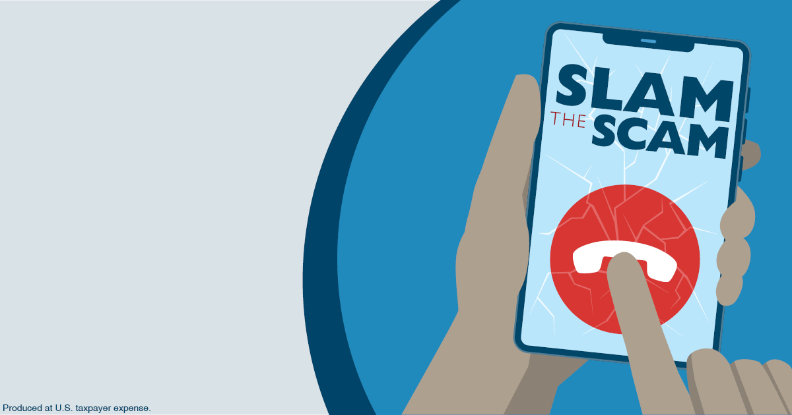
Click to add your message here.
Notes:
Add your agency logo to the picture icon.

Slide 12

Click to add your message here.
Notes:
Add your agency logo to the picture icon.

Slide 13
READY-TO-SHARE TEMPLATE
Save the template slides as an image.
Create your own captions. Use our provided captions for guidance or copy and paste them.
Share #SlamTheScam content during National Consumer Protection Week, March 1-7, and don’t forget to reshare other #SlamTheScam posts.

Slide 14


Slide 15
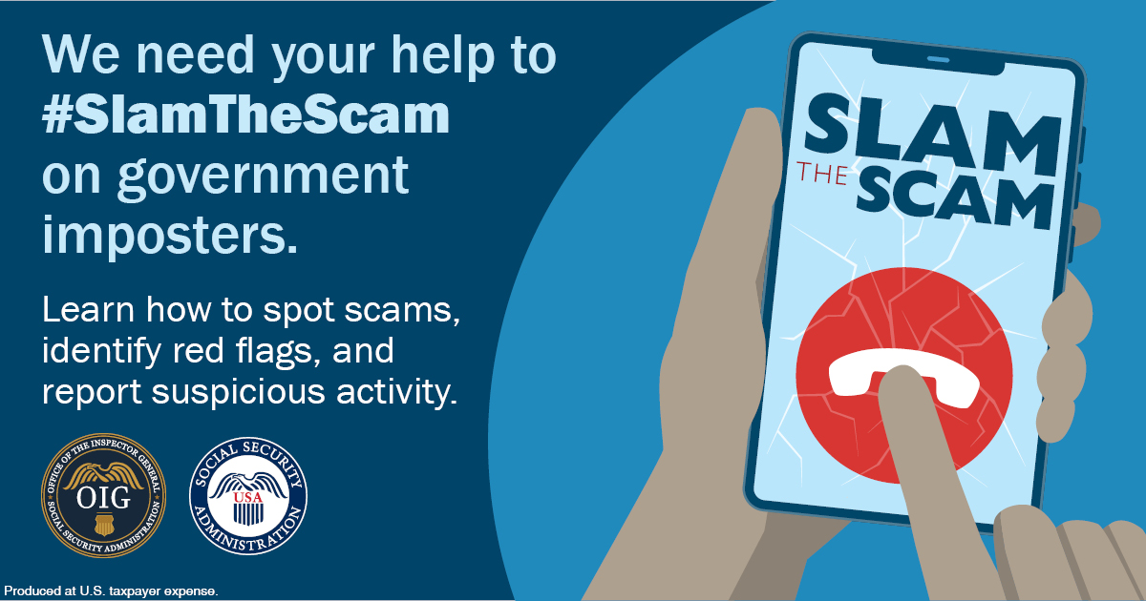

Slide 16
Captions
Copy, paste, and share the messages below to support National Slam the Scam Day or create your own messages. Add hashtags such as #SlamTheScam, #NCPW2026, and #NCPW to your message and remember to share. Let’s get the word out to as many people as possible.
Received a suspicious call, text, letter, or email? Take action to protect yourself and follow these steps to #SlamTheScam: ssa.gov/scam
It’s National Consumer Protection Week! Help us #SlamTheScam—don’t let government imposters fool you. Spot scams, know the red flags, and report suspicious activity at ssa.gov/scam. #NCPW2026
Avoid becoming the victim of fraud and know what to do if your #SocialSecurity information is compromised. Help us #SlamTheScam and stop government imposters in their tracks. ssa.gov/scam
Scammers may pose as government officials and pressure you for immediate payment. Don’t fall for it! #SlamTheScam and HANG UP! Report suspicious activity at: ssa.gov/scam
Help us #SlamTheScam on government imposters. Learn how to spot scams, identify red flags, and report suspicious activity: ssa.gov/scam

Slide 17
Captions | Spanish
Copy, paste, and share the Spanish messages below to support National Slam the Scam Day or create your own Spanish messages. Add hashtags such as #OjoConLasEstafas, #SlamTheScam, #NCPW2026, and #NCPW to your message and remember to share. Let’s get the word out to as many people as possible.
¿Sabe usted qué hacer si recibe una llamada, un mensaje de texto, una carta por correo, o un email de una persona que intenta estafarlo? ssa.gov/espanol/estafas/ #OjoConLasEstafas #NCPW2026
Esta es la Semana Nacional de Protección del Consumidor, y solicitamos su ayuda para mantener un #OjoConLasEstafas. Infórmese mejor sobre cómo identificar estafas, señales de estafas, y cómo reportar asuntos sospechosos, visitando: ssa.gov/espanol/estafas/ #NCPW2026
Evite ser la victima de frauda e infórmese mejor sobre qué medidas puede tomar si su información confidencial del #SeguroSocial está en peligro. Ayúdenos a mantener un #OjoConLasEstafas y pararemos en seco a estos impostores. ssa.gov/espanol/estafas/ #NCPW2026
Los estafadores se hacen pasar por empleados del gobierno. Es probable que lo amenacen y exijan un pago inmediato. ¡No se deje engañar! ¡Mantenga su #OjoConLasEstafas y CIERRE LA LLAMADA! Reporte la estafa en: ssa.gov/espanol/estafas/ #NCPW2026
Necesitamos su ayuda para mantener un #OjoConLasEstafas y a los impostores. Infórmese mejor sobre cómo identificar una estafa, las señales de estafas, y cómo reportar asuntos sospechosos. Visite: ssa.gov/espanol/estafas/ #NCPW2026

Slide 18
#SLAMTHESCAM
Find more scam awareness resources and information at ssa.gov/scam

