Slide 1

Foundations for Evidence-Based Policymaking Act [EBPA] & the Federal Data Strategy 2020 Action Plan
Data Governance Board
February 6, 2019

Slide 2
Welcome to the 2nd Data Governance Board Meeting!

Slide 3
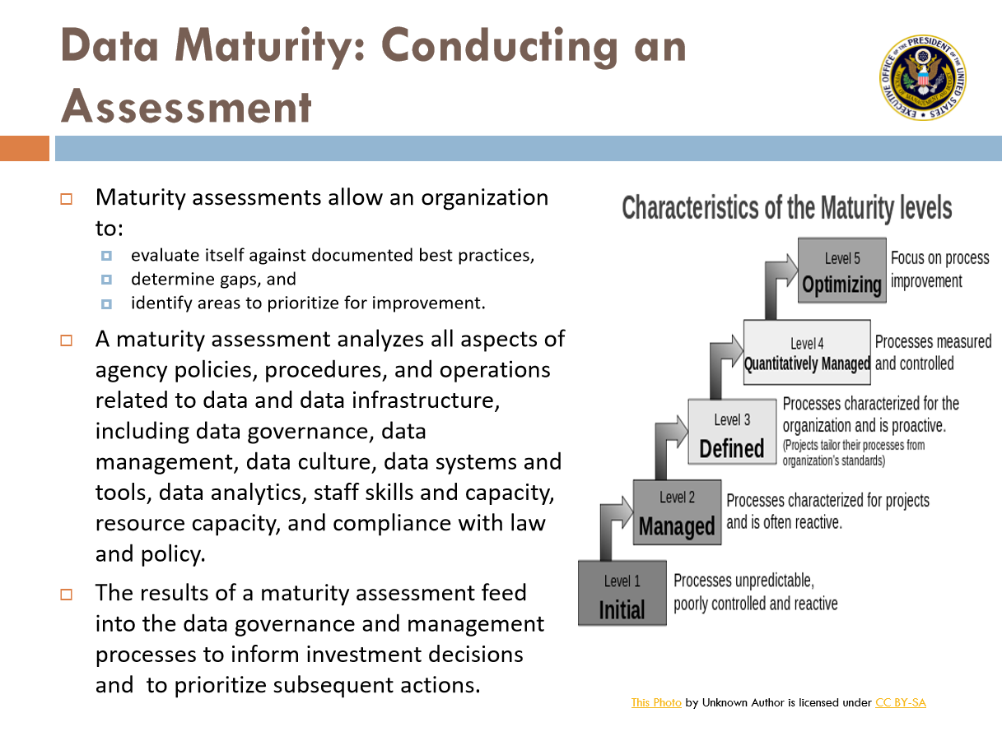

Slide 4
