Slide 1

Foundations for
Evidence-Based Policymaking Act of 2018 [EBPA]
Data Governance Board
November 5, 2019

Slide 2
Overview
Brief History and Background
OMB Implementation Plan: Four Phases
  Phase 1 Guidance
Personnel and Planning Activities
Learning Agenda Framework
Next Steps for Data Governance Board
Questions, Suggestions, Recommendations?

Slide 3
History and Background
Bi-Partisan Commission on Evidence-Based Policymaking
  Released final report to Congress in September of 2017
  Intended to address, “the greatest problems facing evidence building today—data access is limited, privacy-protecting practices are inadequate, capacity to generate evidence to support policy decisions is insufficient.”
  Report was integral in developing and legislating EBPA.
EBPA contains three titles of import:
  Title I: Federal Evidence-Building Activities
  Title II: Open Government Data Act
  Title III: Confidential Information Protection and Statistical Efficiency
Notes:
Foundations for Evidence-Based Policymaking Act of 2018
Introduced by Paul Ryan and Patty Murray after release of the Commission’s final reported
Signed by the President and enacted into law on January 14, 2019 as P.L. 115-435

Slide 4
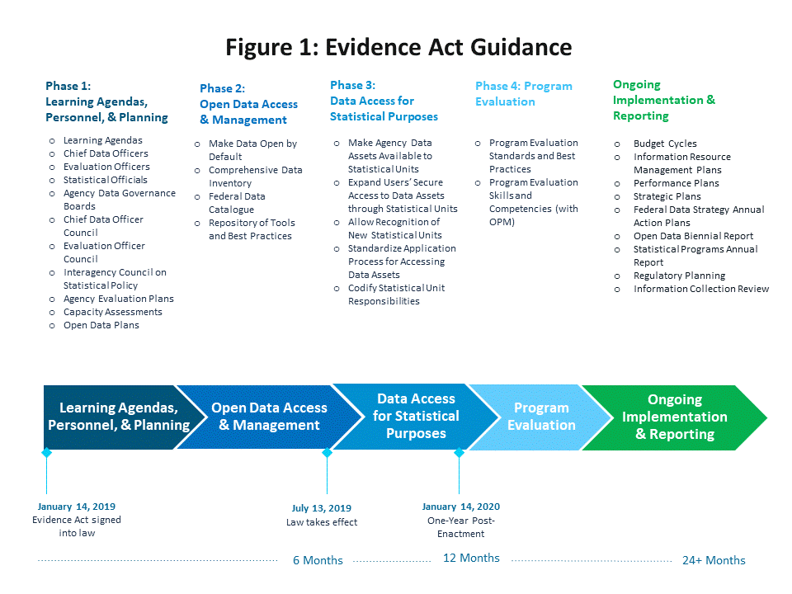

Slide 5
Phase I Guidance: Personnel
Designate three senior agency officials:
  Laura Train [ODEPPIN], Chief Data Officer: Coordinates and chairs SSA’s Data Governance Board (DGB).
  Susan Wilschke [ORDES], Evaluation Officer: Oversees Learning Agenda, Evaluation Plan, and Capacity Assessment.
  Kate Bent [ORES], Statistical Official: Consults on data quality and confidentiality standards .
  Each designated official must serve on respective interagency council.
Establishment of an agency Data Governance Board:
  Implements and recommends data management strategies to strengthen evidence-building.
  Proactively assesses the utilization of data throughout the agency.
  Support the development and implementation of the learning agenda, evaluation plan, and capacity assessment
  Consults on agency data policy and coordinates implementation of the Federal Data Strategy and EBPA.

Slide 6
Chief Data Officer – Role & Responsibilities
OMB emphasizes that this position is primarily an enterprise-wide coordinator role.
OMB expects the CDO to facilitate enterprise-wide policy and administrative recommendations pertaining to data governance, lifecycle data management, information technology, and cybersecurity.
The CDO will coordinate with the DGB and other SSA components on the following:
  Paperwork Reduction Act functions [will continue to be performed by OLCA]
  Records management functions [will continue to be overseen by the official of jurisdiction]
  The Agency Open Government/Data Plan [will continue to be performed by OCOMM]
  Implementation of the Federal Data Strategy, and
  An annual report to the Congress on the Agency’s compliance with EBPA.

Slide 7
Phase 1 Guidance: Planning
EPBA Augments Strategic Planning Activities Consistent with the Following:
  GPRA Modernization Act;
  OMB Circular A-11 Part VI;
  Federal Data Strategy; and
  Agency specific management routines, such as data-driven performance and strategic reviews.
Strategic Planning and Performance Process Shall Include [target Feb. 2022]:
  Learning Agenda: Identifies, prioritizes, and establishes strategies to develop evidence.
  Annual Evaluation Plan: Details current and future evaluation activities an agency plans to undertake.
  Capacity Assessments: Assesses capacity and infrastructure of SSA to assess ability to carry out evidence-based activities.
    Foundational fact finding, performance measurement, policy analysis, and program evaluation.

Slide 10
Next Steps for DGB
Finalize DGB Charter (Draft Charter attached to meeting invitation)
Establish Governance Structure
Develop the Agency Data Catalog
Conduct a Data Maturity Assessment
Consult on learning agenda, capacity assessment, and evaluation plans
Submit reports to Congress
Complete Federal Data Strategy Action Items (Waiting for OMB guidance)
Complete Open Data Plan (Waiting for OMB guidance)
Conduct Regular Meetings

Slide 11
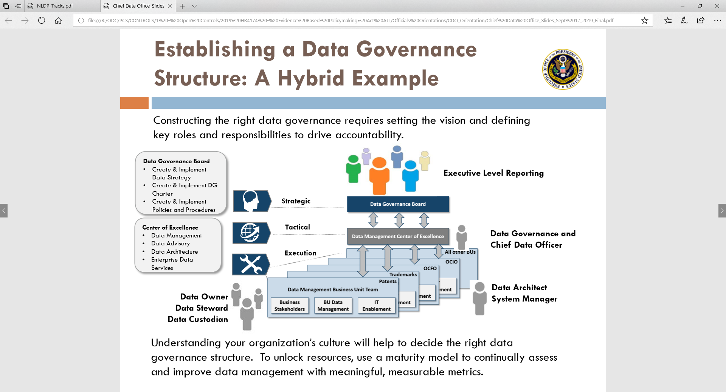

Slide 12
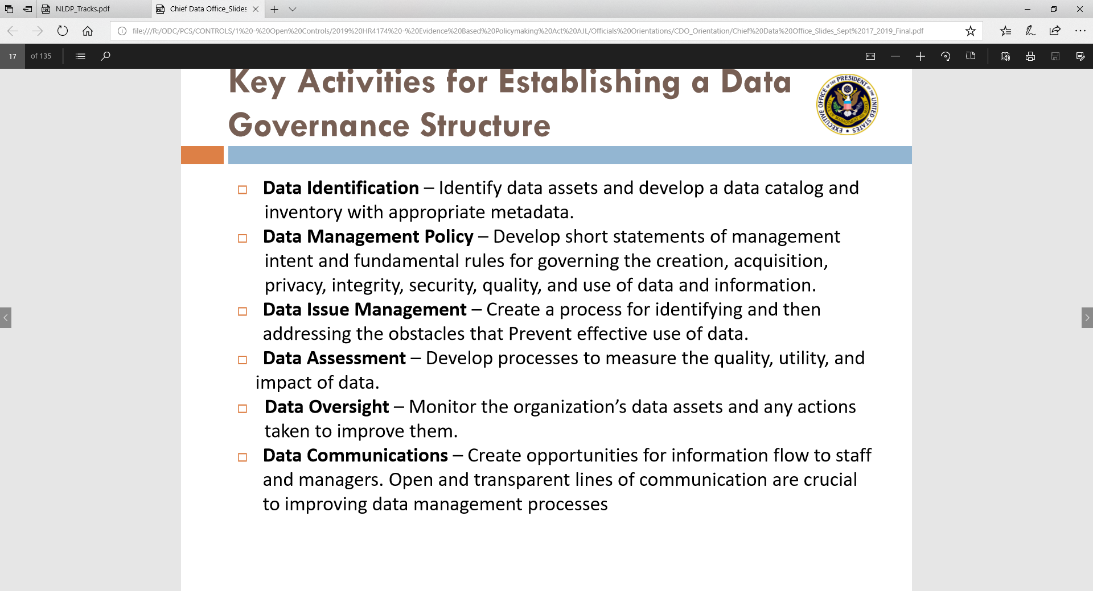

Slide 13
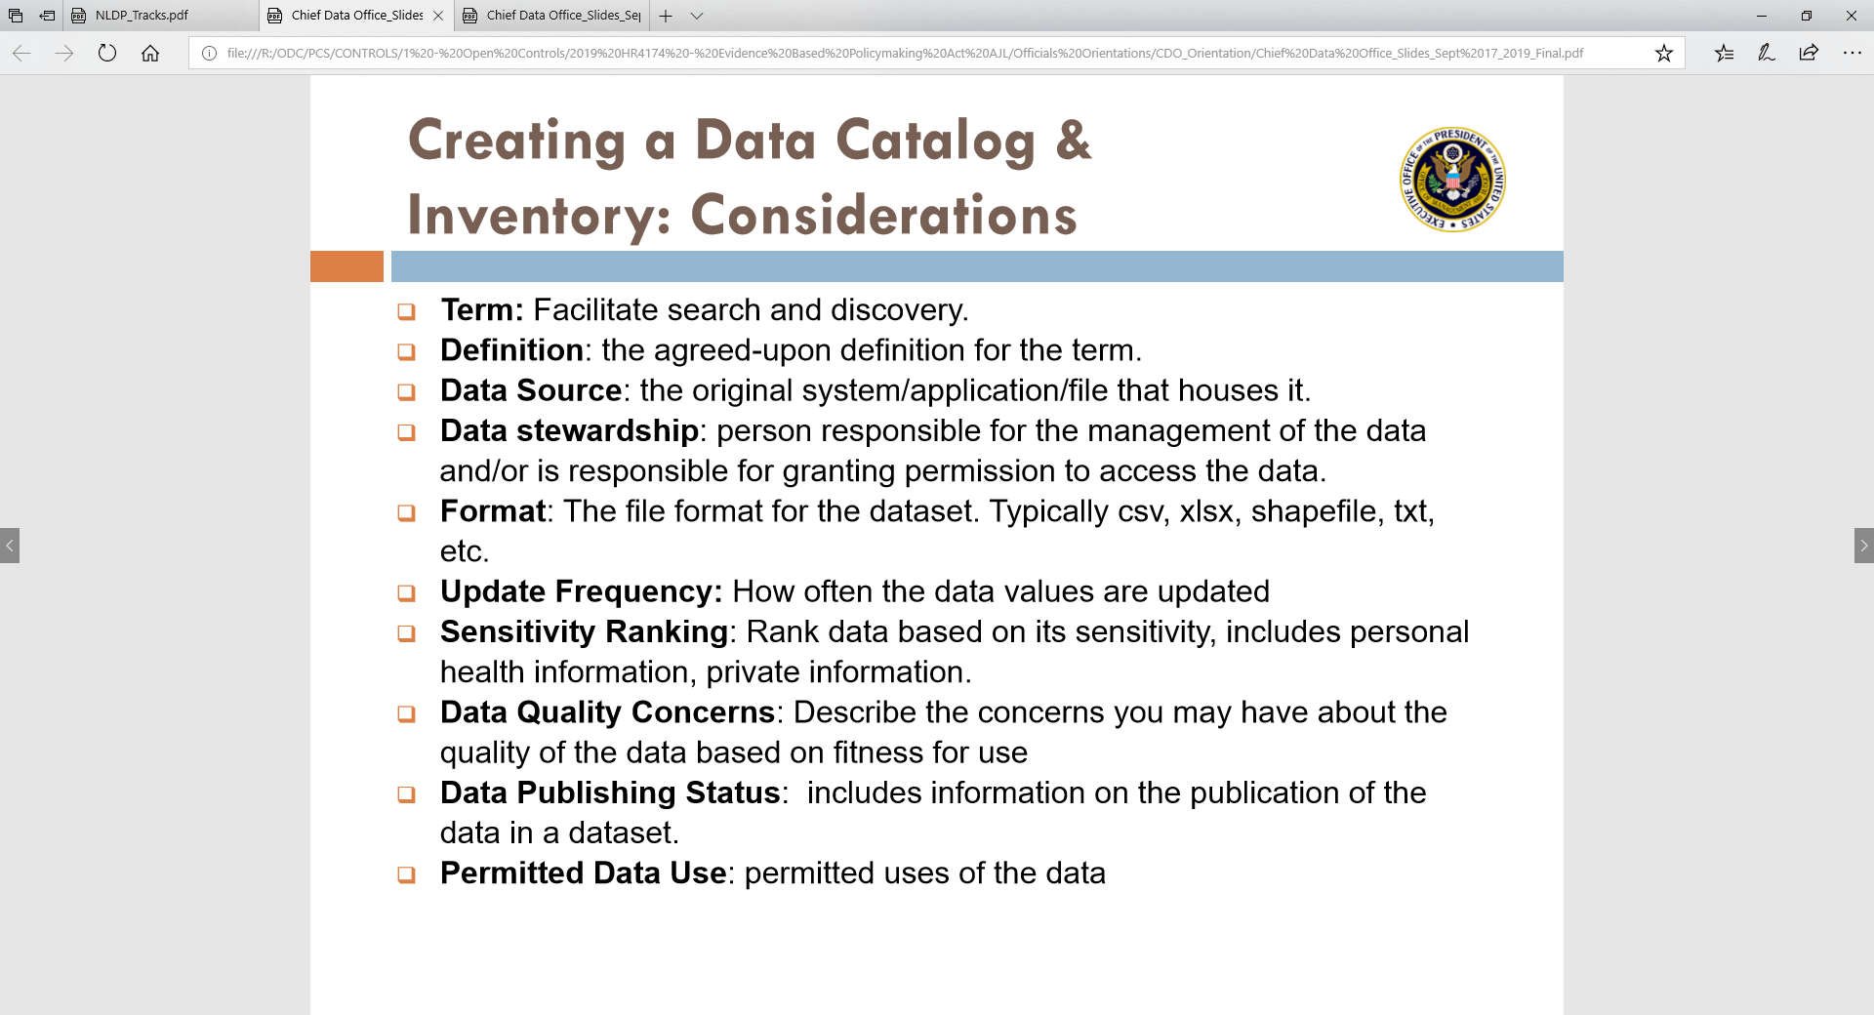

Slide 14
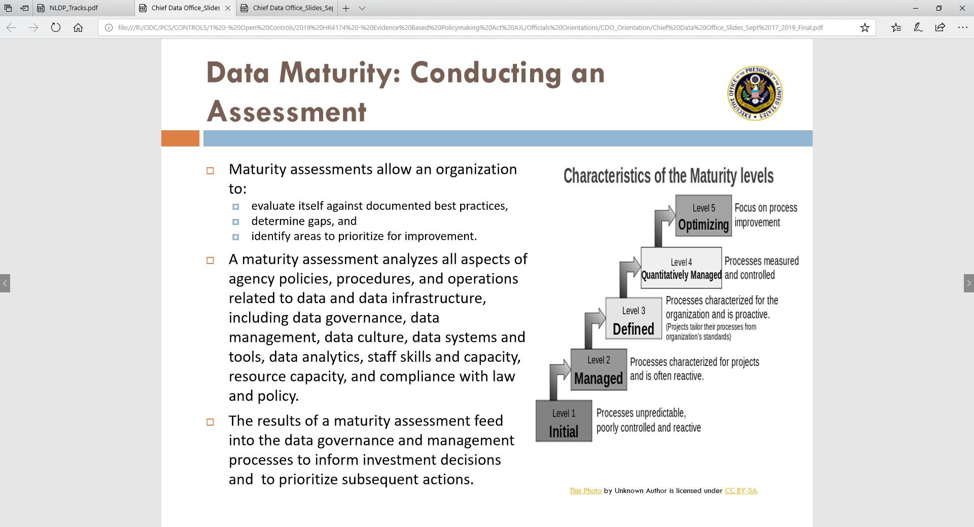

Slide 15
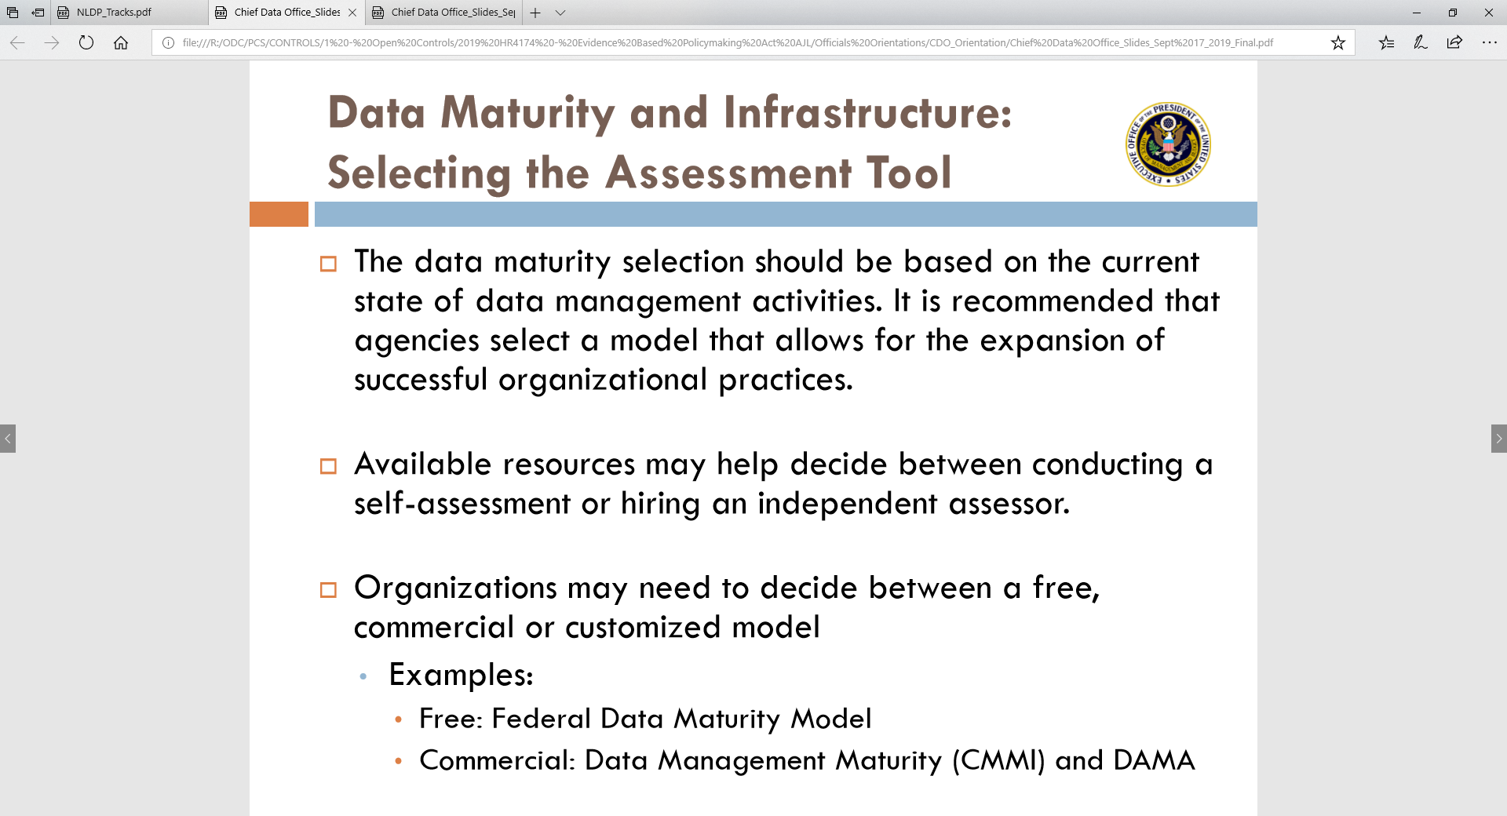

Slide 16
Questions, Suggestions, Recommendations?

