Slide 1

How to Register and Get an Activation Code For
Business Services Online

Slide 2
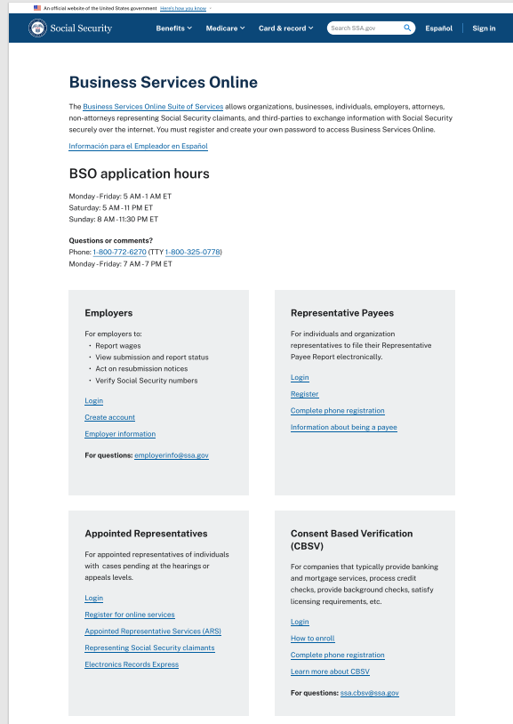
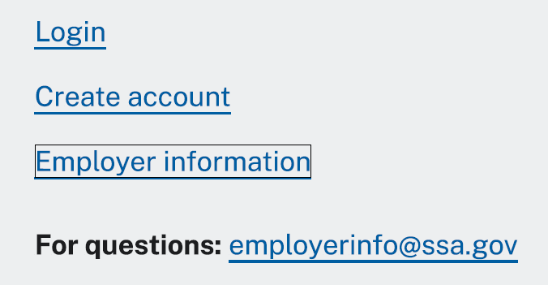
Select the "Create account" link

Slide 3
Business Services Online Welcome Page
Point your browser to the Business Services Online (BSO) Welcome page: www.ssa.gov/bso
Select the Create account button in the employer box on the Business Services Online Welcome page.

Slide 4
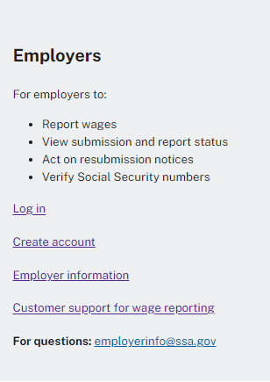
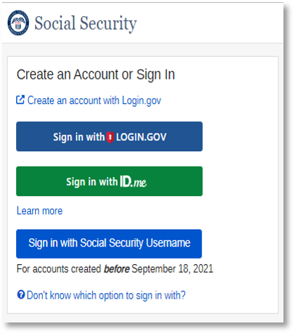
LINKS ON THE LEFT TAKE YOU TO THE SCREEN ON THE RIGHT

Slide 5
Select "Create an account with Login.gov"
Note: If you already have a Social Security account, Login.gov, or ID.me account, please sign in with one of those options.

Slide 6
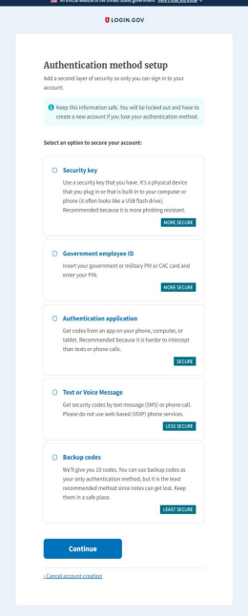
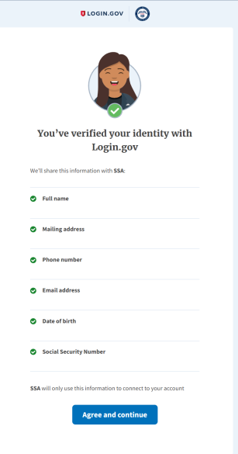
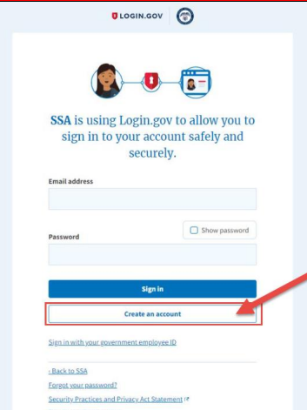
Follow the Login.gov Create an account option

Slide 7
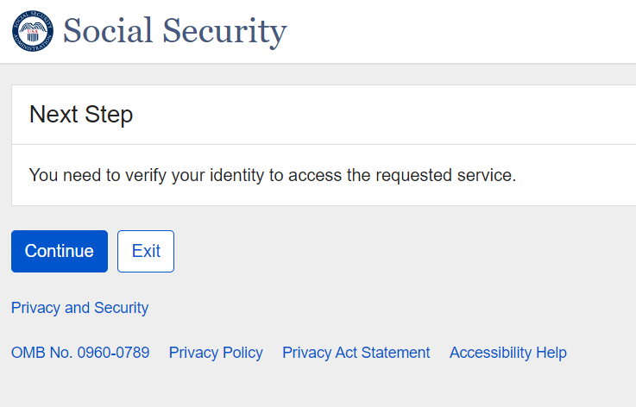
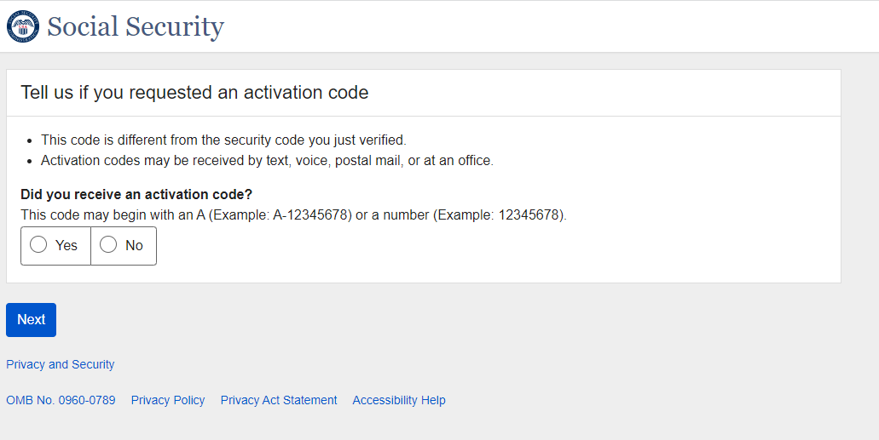
Complete these additional steps to finalize the process to verify your identity
Select the "No" radio button that you have not received an activation code yet.

Slide 8
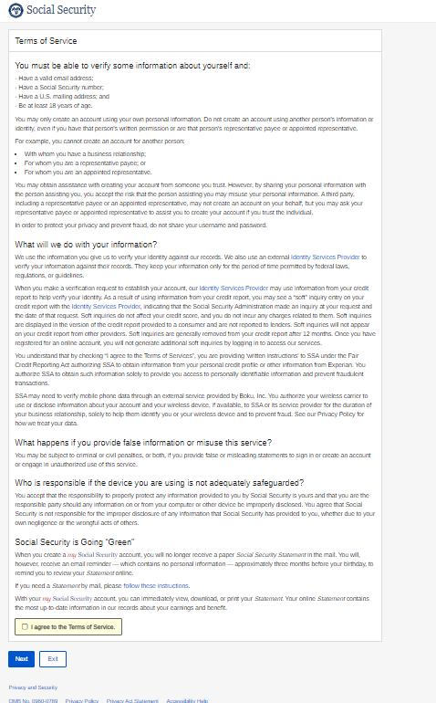
Select "I agree to the Terms of Service."
Then select "Next"

Slide 9
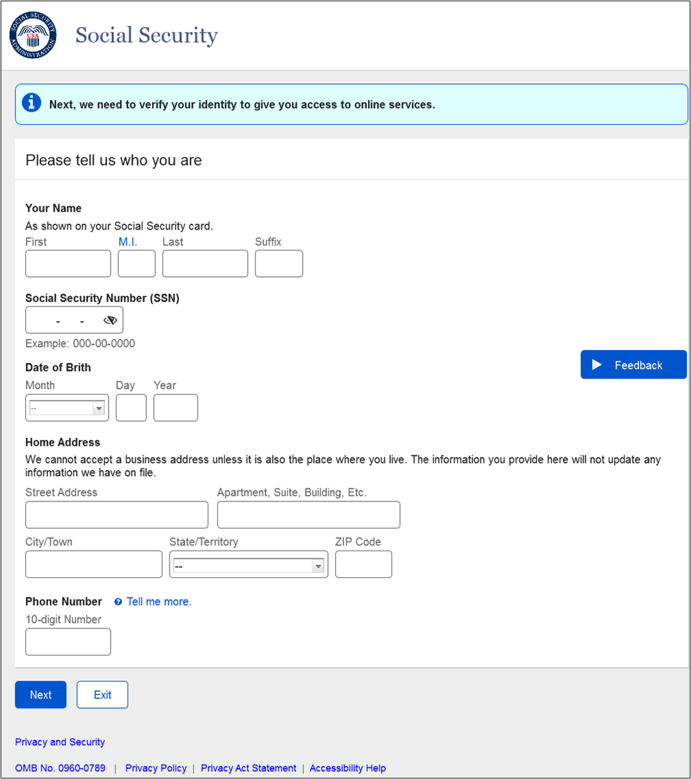
Verify Your Identity
Enter your personal information so we may identify you.
  The information you provide when you register allows us to confirm your identity before issuing a User ID.
  Your employer will NOT see your personal information OR have access to it.
  Your personal Social Security account and BSO account will remain separate.

Slide 10
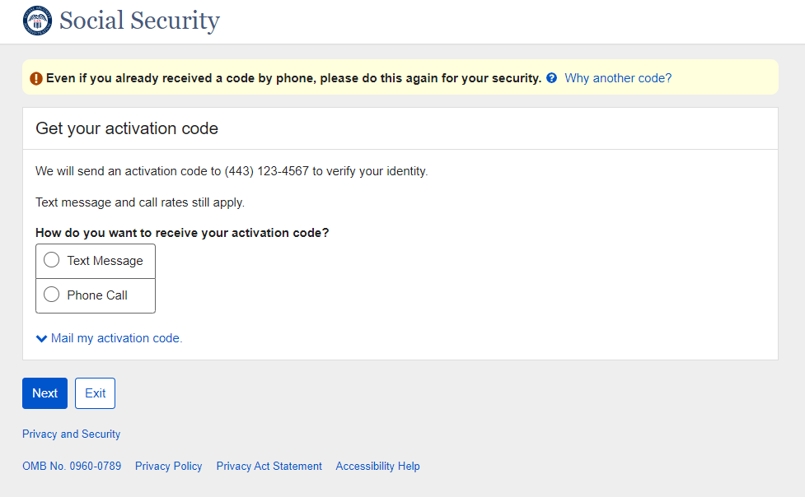
Choose how you want to receive the activation code
Choose how you want to receive the activation by selecting the radio button of your choice.
You have the option to receive it by text message on your personal mobile phone or a phone call.
111-111-1111

Slide 11
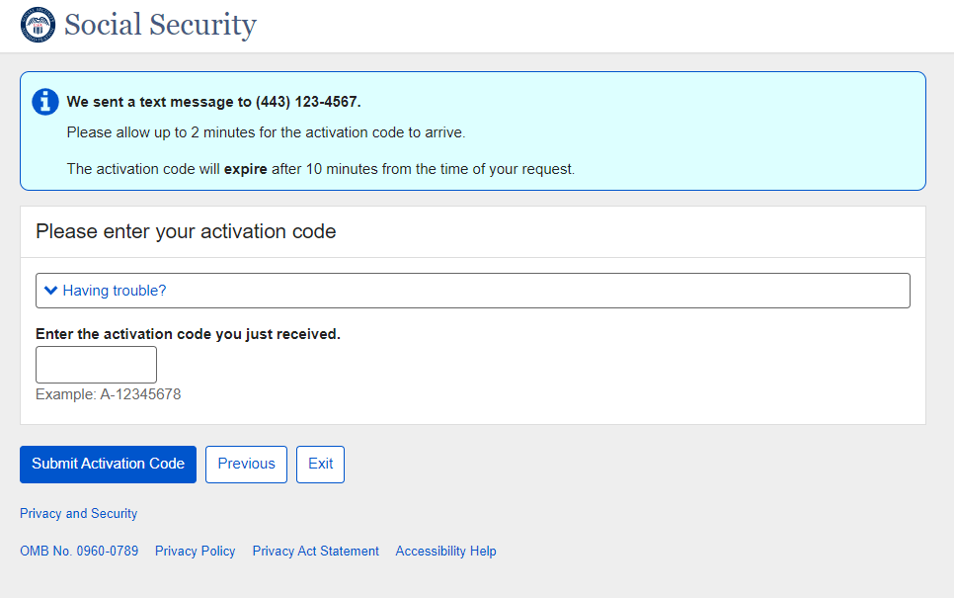
Enter the activation code and select
"Submit Activation Code"
111-111-1111

Slide 12
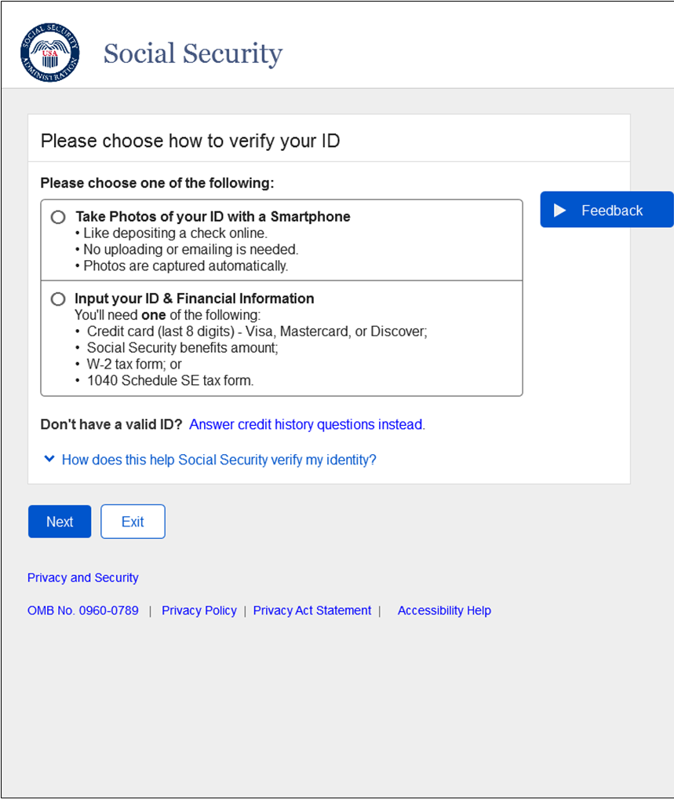
Choose How To Verify Your ID
Next, choose how to verify your identity by selecting the radio button of your choice.
You can choose:
To take photos of your ID with a smartphone.
  Take clear pictures of both the front and back of your state issued ID when prompted.
Input your ID and financial information.
  You use one of the following:
    Credit card
    Social Security benefits amount
    W-2s schedule SE

Slide 13
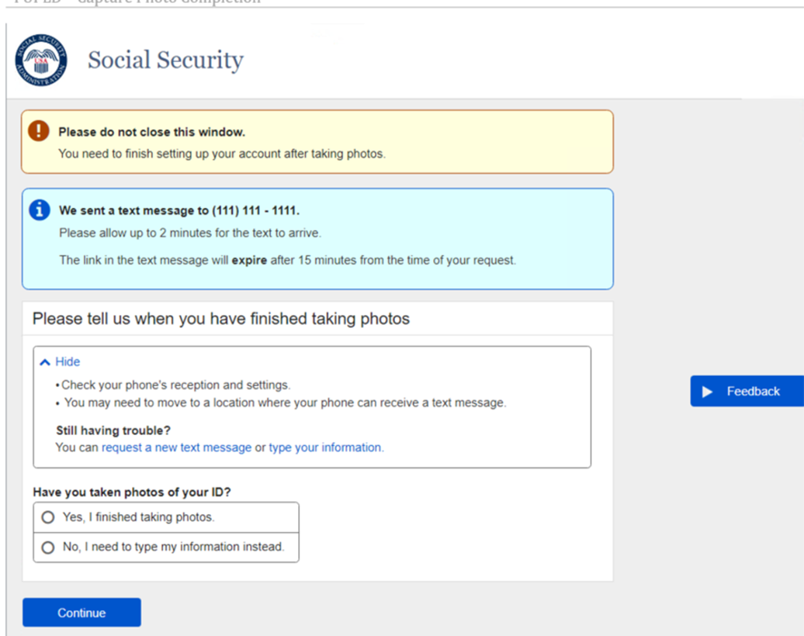

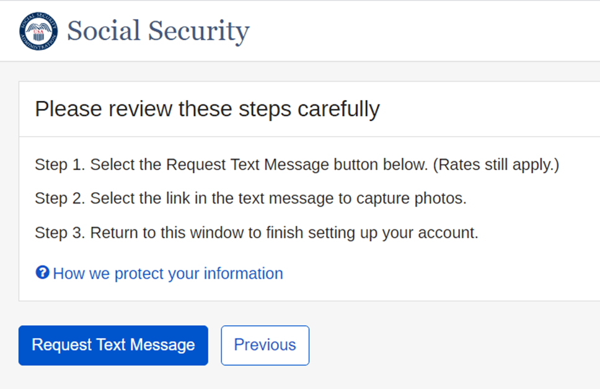
Steps to take photos with your smart phone
1st radio button path

Slide 14

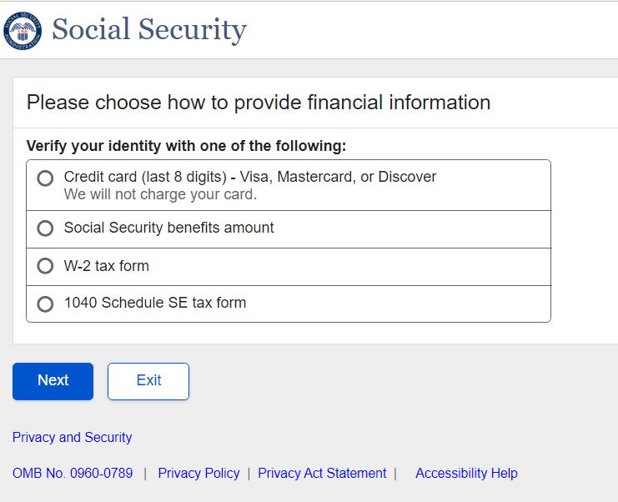
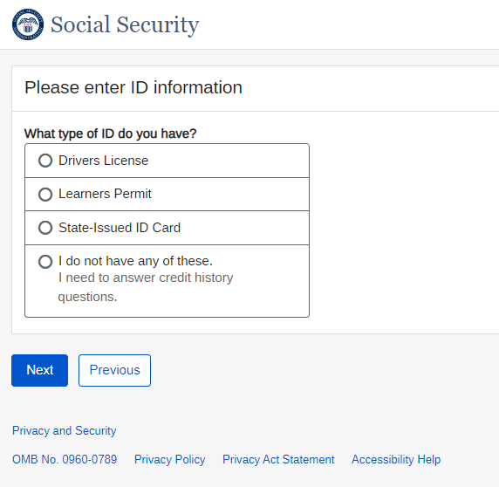
Steps to verify your financial information
2nd radio button path
1.
3.
2.
Select next as you provide the requested information

Slide 15
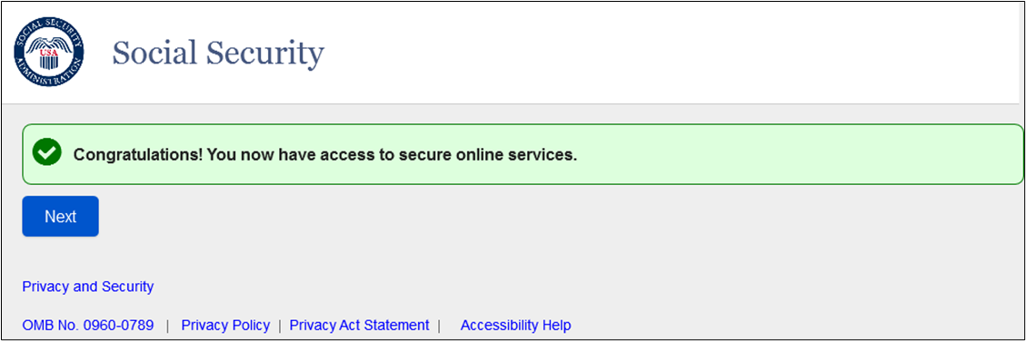
You have successfully authenticated your identity

Slide 16
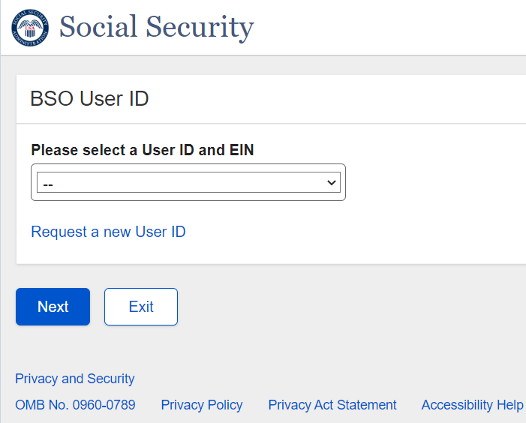
Select ‘Request a new User ID’ and select ‘Next’

Slide 17
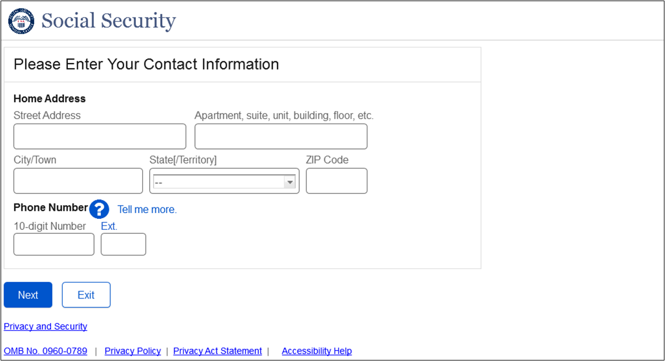
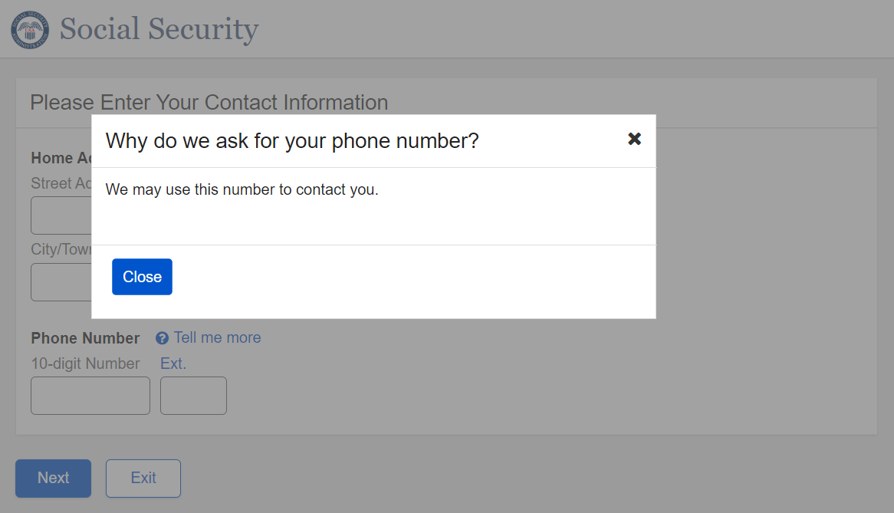
Enter your personal contact information

Slide 18
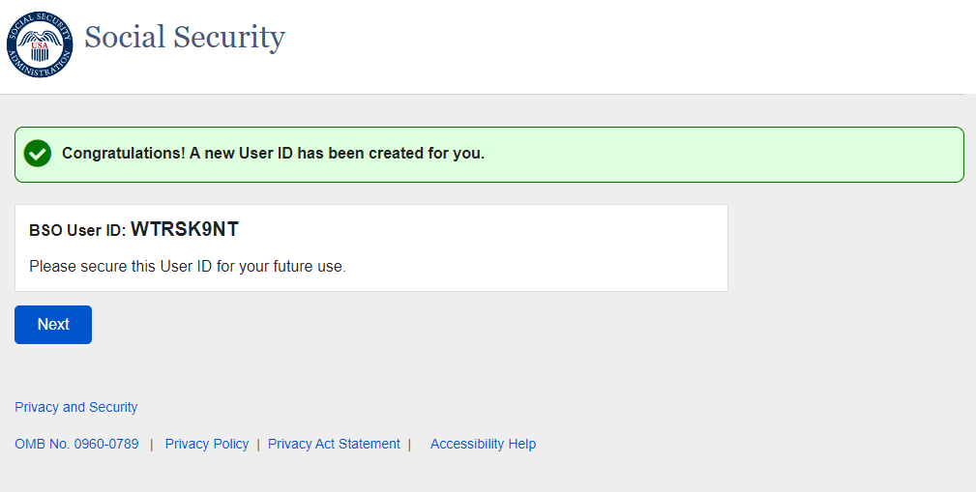
Your new BSO User ID has been created
xxxxx1xx

Slide 19
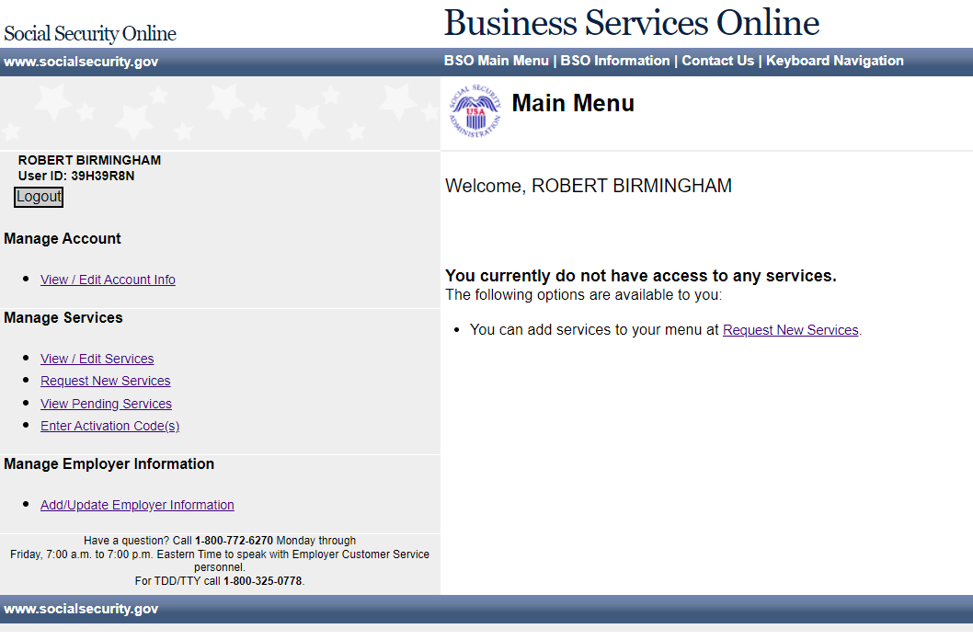
BSO Main Menu
Select the "Request New Services" link in the Main Menu or the left navigation panel.
The system displays the Request Access to Services page.
John Public
User ID :xxxxxxxx
John Public

Slide 20
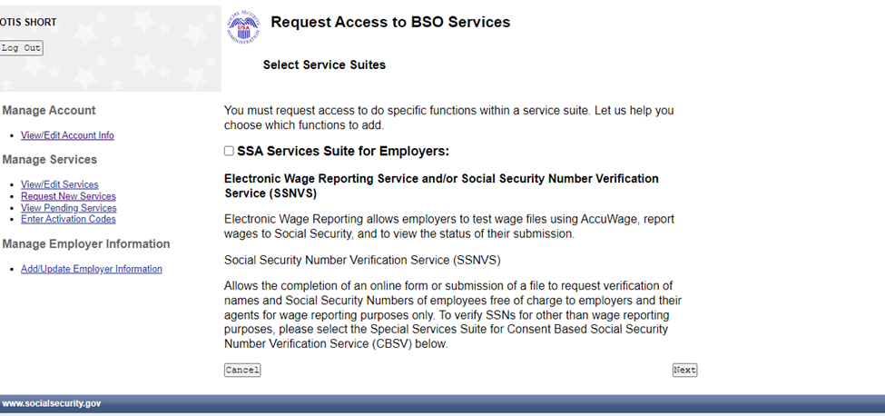
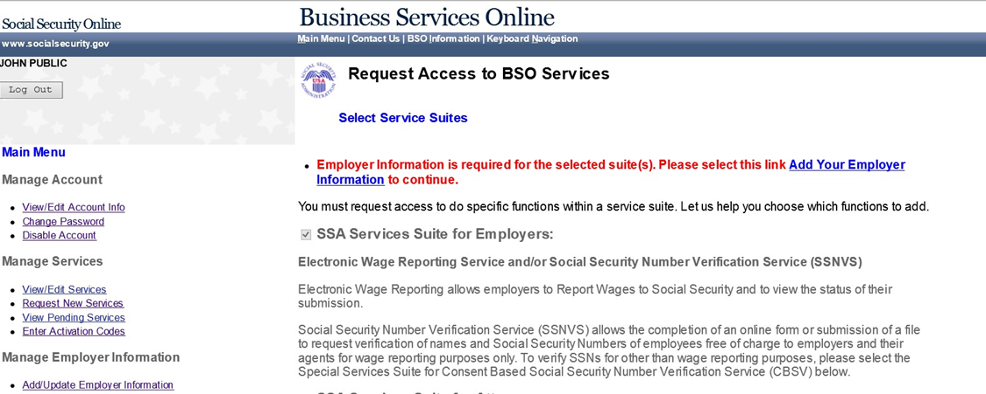
Request Access to BSO Services
Check the checkbox, “SSA Services Suite for Employers:” and select the Next button.
To enter the Employer information, select the Add Your Employer Information to continue.”
If Employer information has already been entered, the system displays the Adding Services Wizard pages for the suite(s) of services you selected.

Slide 21
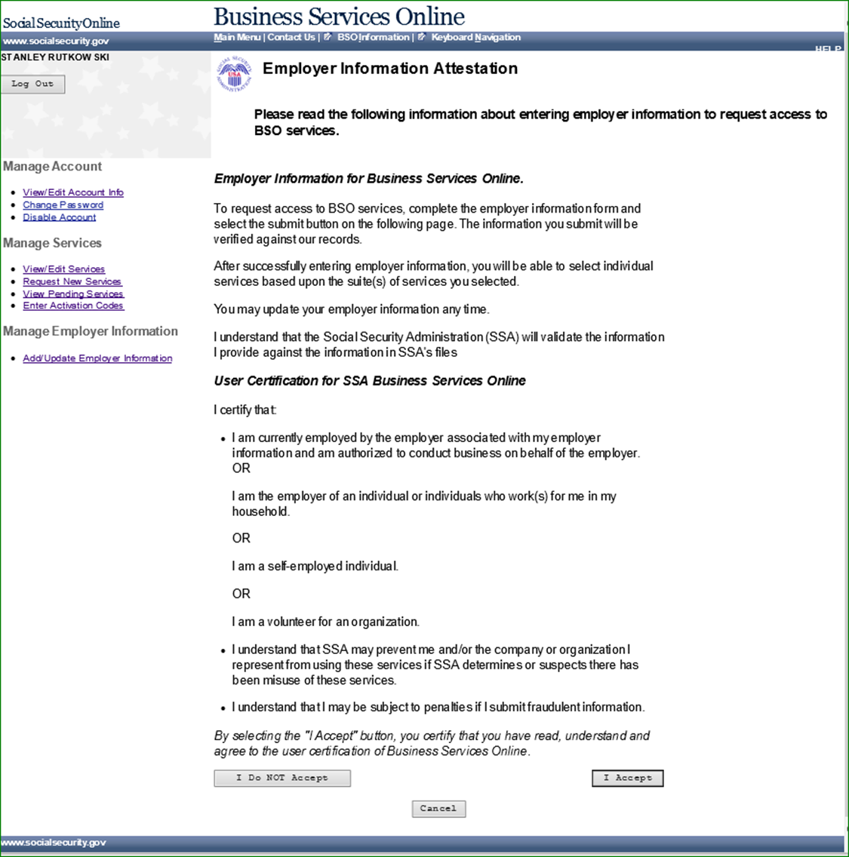
Request access to BSO services
Select the "I Accept" button on the Employer Information Attestation.

Slide 22
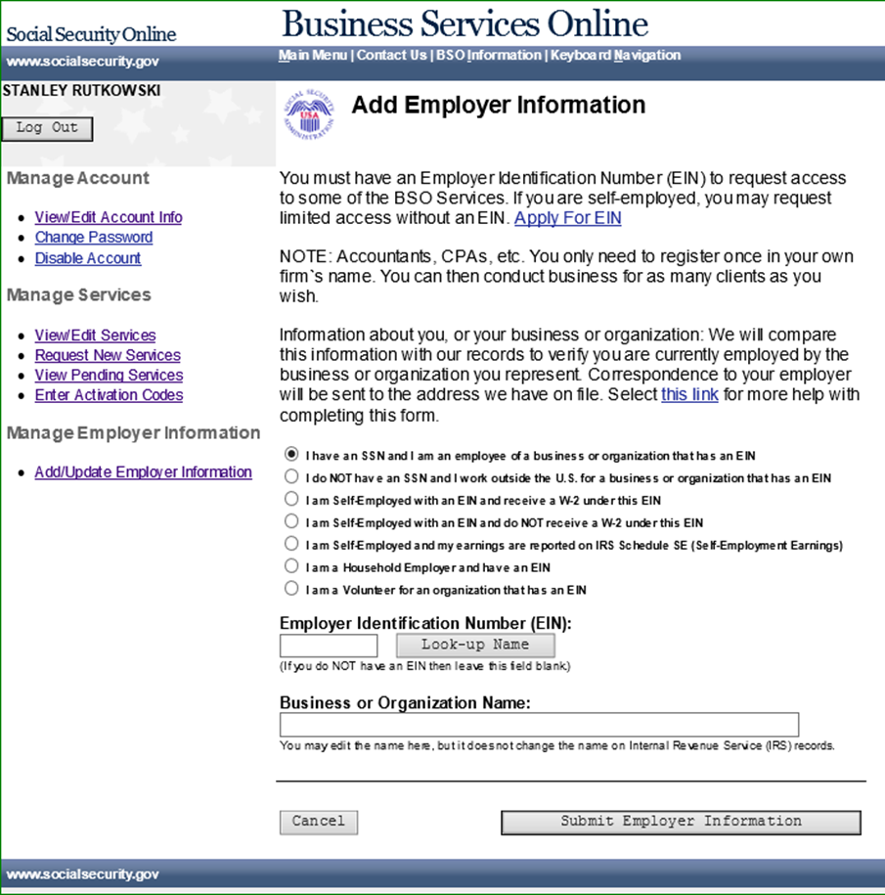
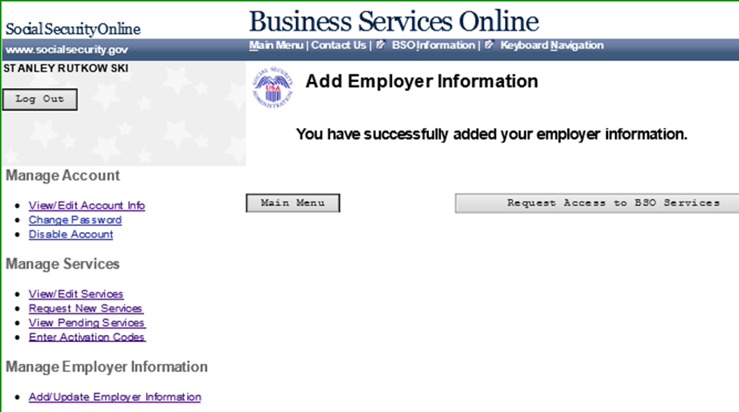
Add employer information
Select the radio button for the statement
that applies to you; then enter the Employer Identification Number (EIN) and name of the business you work for.
Select "Submit Employer Information" to continue.
On the "Add Employer Information" page select "Request Access to BSO Services".

Slide 23
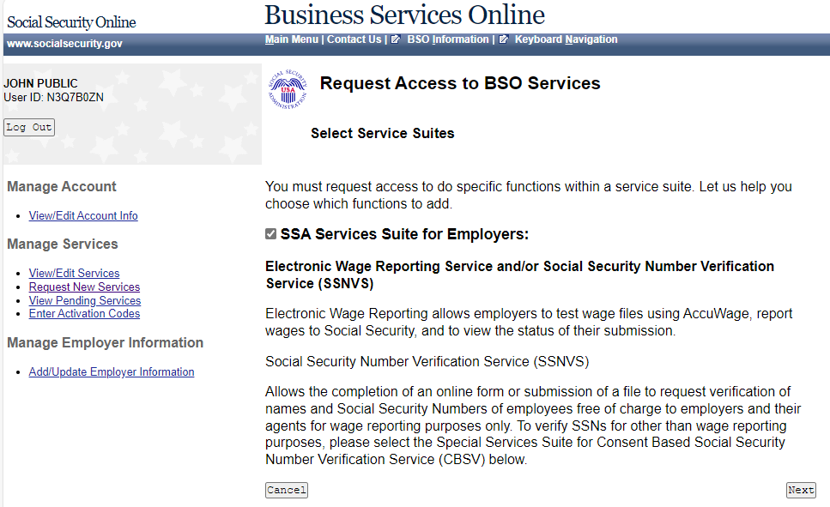
Request Access to BSO Services
Check the checkbox saying “SSA Services Suite for Employers:” and select the Next button.

Slide 24
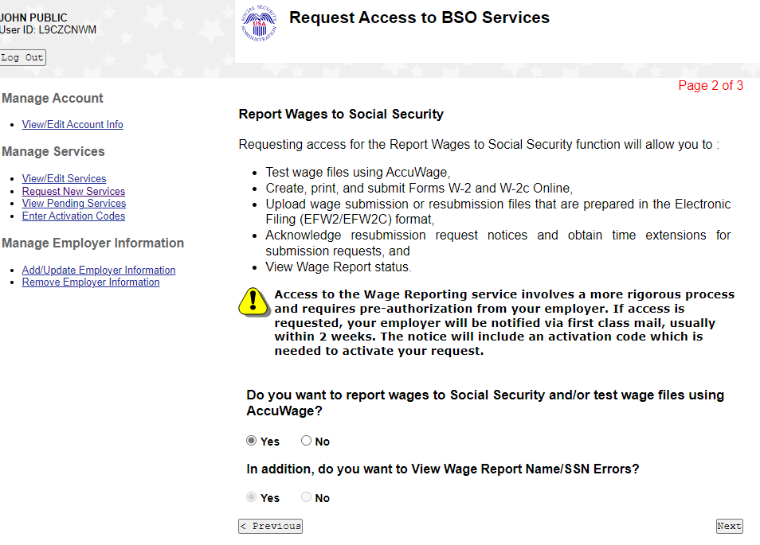
Request Access to BSO Services
Answer the questions:
"Do you want to report wages to Social Security and/or test wage files using AccuWage?" and
‘In addition, do you want to view wage report name SSN errors?’
Select "Next."

Slide 25
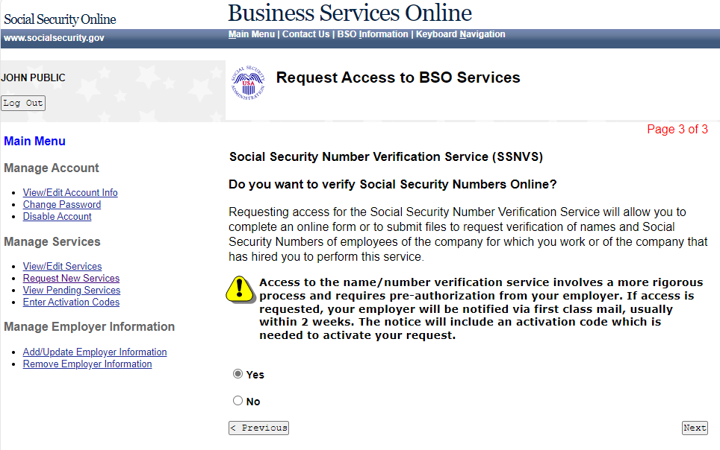
Request Access to BSO Services
To request access to Social Security Number Verification Service (SSNVS) Select “Yes” radio button and then "Next."
Notes:
Request access to any service requires preauthorization from your employer. If access is requested, your employer will be notified via first class mail, usually within 2 weeks. The notice will include an activation code which is needed to activate your request.

Slide 26
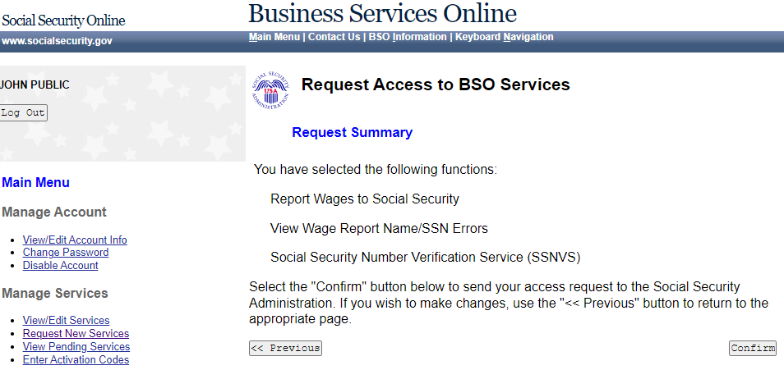
Confirm
Review the summary of services selected and
Select "Confirm" to submit your access request.

Slide 27
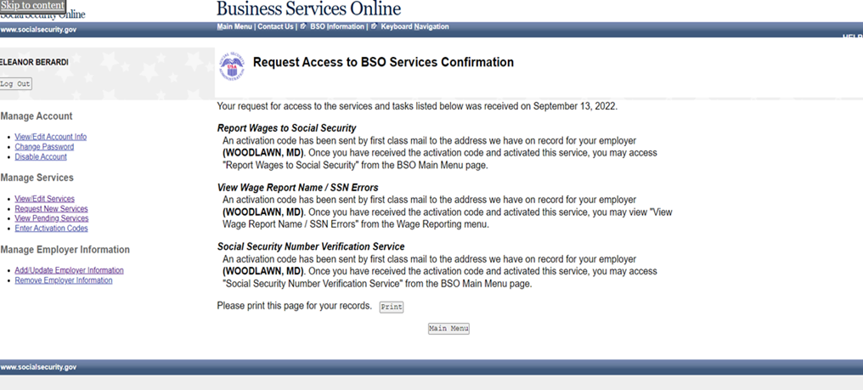
Request Access to BSO Services Confirmation
The confirmation page shows what services were selected. Please print this page for your records.
Activation codes will be mailed to the address we have on record for your employer and are usually received within two weeks.
Activation codes will enable you to access the services you have chosen.
Note: If you request more than one service, you will receive a separate activation code for each service.
Please Note: If the activation code(s) do not arrive at the address shown for your employer within two weeks, you may re-request them.
Refer to the Re-Request Activation Codes lesson in the BSO Tutorial for Tax Year 2023 (ssa.gov).

Slide 28
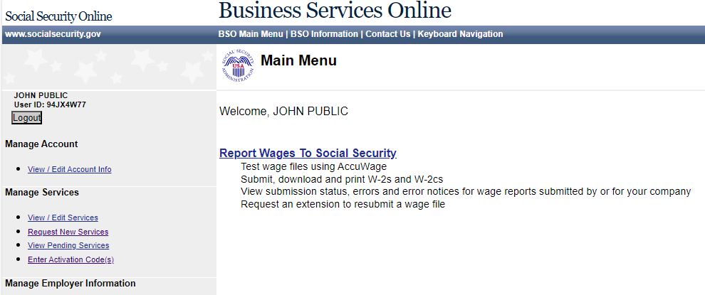
BSO Main Menu
Once you receive your mailed activation code, log back in.
Once you have navigated to the BSO main menu, select the
Enter Activation Code(s) link on the left navigation panel.

Slide 29
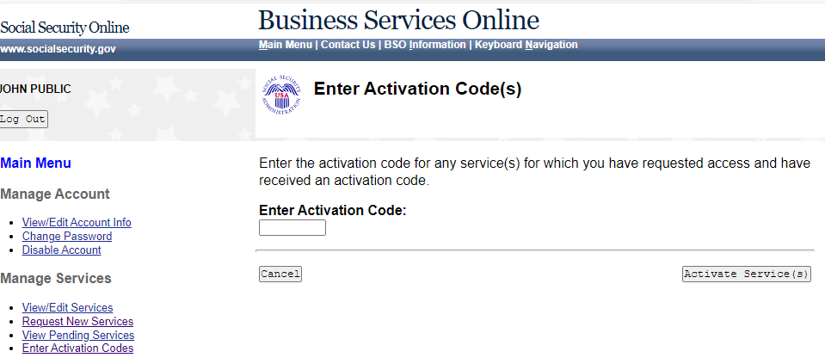
Enter Activation Codes
Enter the activation code in the Enter "Activation Code" field and select the
"Activate Service(s)" button.

Slide 30
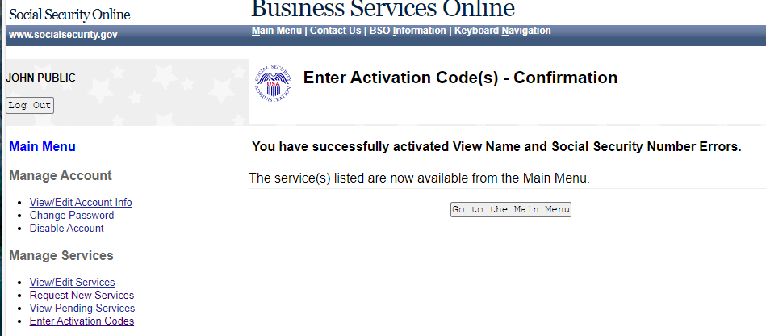
Enter Activation Code(s) - Confirmation
The system displays the Enter Activation Code(s) – Confirmation page.
Select the Go to the "Main Menu" button to return to the Business Services Online Main Menu page.
The activated service will be listed.

Slide 31
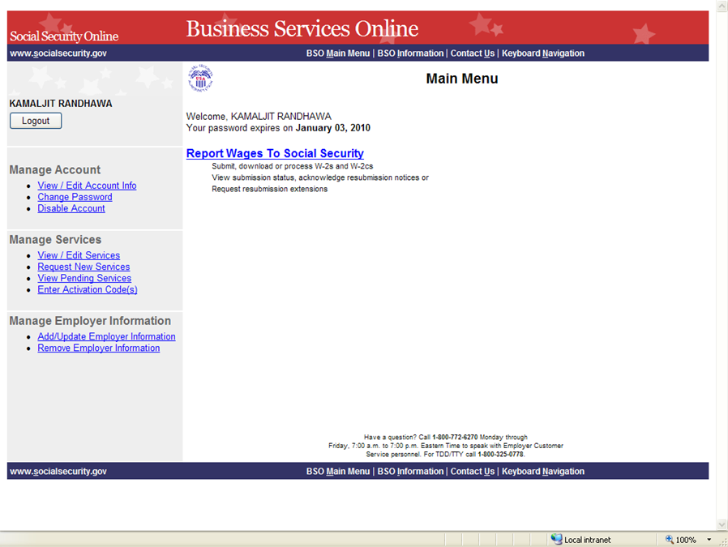
Main Menu
You are now ready to
Report Wages to Social Security.

