Slide 1

What You Need to Know for 2023
This training package provides information to
New and experienced users of Business Services Online.
Employers who mail paper W-2s to SSA and want to learn about filing W-2s electronically.
There are 2 versions of this training package:
    PowerPoint
    PDF

Slide 2
What You Need to Know for 2023
Topics
New security feature for filing wage reports.
Wage File Upload Process
Lowering of the electronic reporting threshold – Taxpayer First Act
Truncated Social Security Numbers
W-2 Online
Does your payroll software create a file?
Fraud Prevention and Reporting

Slide 3
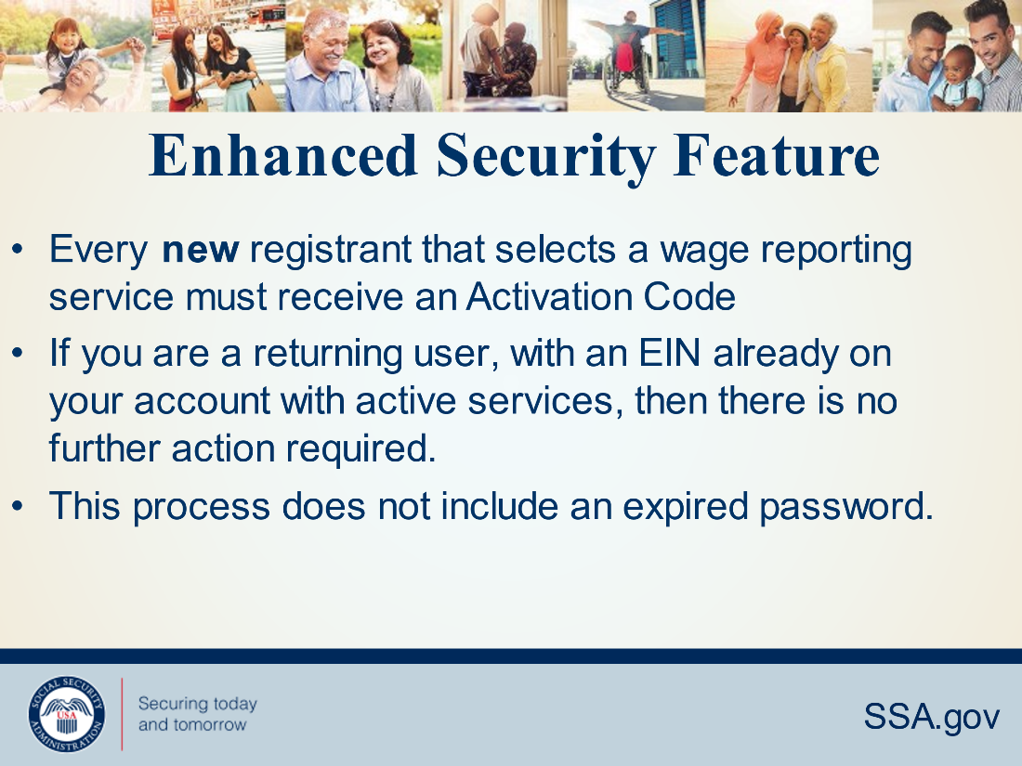
New Security Feature for Filing Wage Reports
Access to the Wage Reporting suite of services requires pre-authorization from the employer. If access is requested, the employer will be notified via first-class mail, usually within 2 weeks. This notice will include an activation code which is needed to activate your request.
You must go through the activation code process for the following services:
  1. Test files using Accuwage
  Create, print, and submit Forms W2 and W2c online
  Upload wage submission or resubmission files that are prepared in the EFW2 or EFW2C format
  Acknowledge resubmission request notices
  View Wage Report status.

Slide 4
Wage File Upload – Overview
  Provide confirmation information in less then 2 minutes.
  You will know immediately if your file passes our online checks*.
You will receive a Wage File Identifier (WFID – SSA’s tracking code for your file) only when your file passes our online checks*.
The system will reject the file and all reports in the file if errors are found in any of the reports.
Errors are listed on the screen in the same file upload session.
You will need to fix all errors and upload again before SSA can process your file.
If your file has multiple reports (W-3s), you have the option to split the file and upload all of the reports without errors while you fix the report(s) that has/have errors and upload that file later.
* There are a few conditions SSA does not verify in real-time. One of these conditions is whether reported name/Social Security Number match SSA’s records.

Slide 5
Business Services Online – Overview
If you are already registered to use BSO, choose Log In.
If you need to register for BSO, start at BSO Welcome Business Services Online (ssa.gov) and choose Register.
For help information, please go to the Employer W-2 Filing Instructions & Information (ssa.gov).
The following pages show a s.tep-by-step process, starting with logging into Business Services Online (BSO).

Slide 6
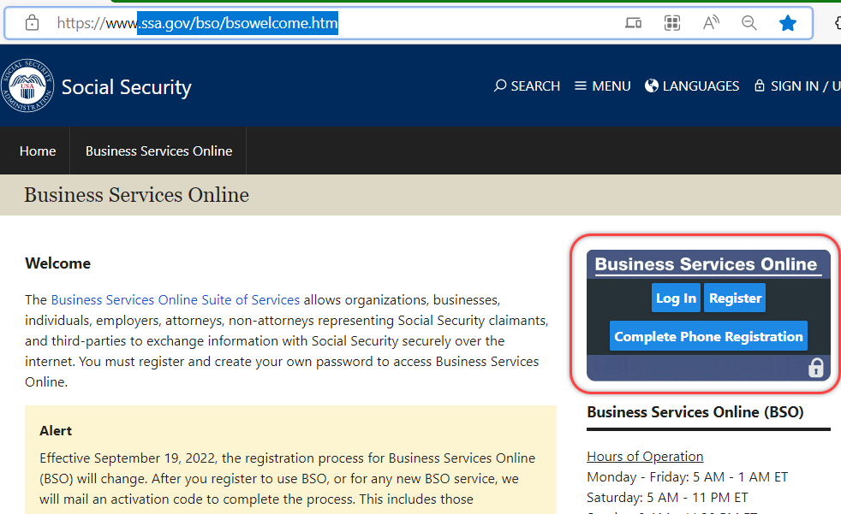
Start at Business Services Online (BSO) Welcome
Step 1:

Slide 7
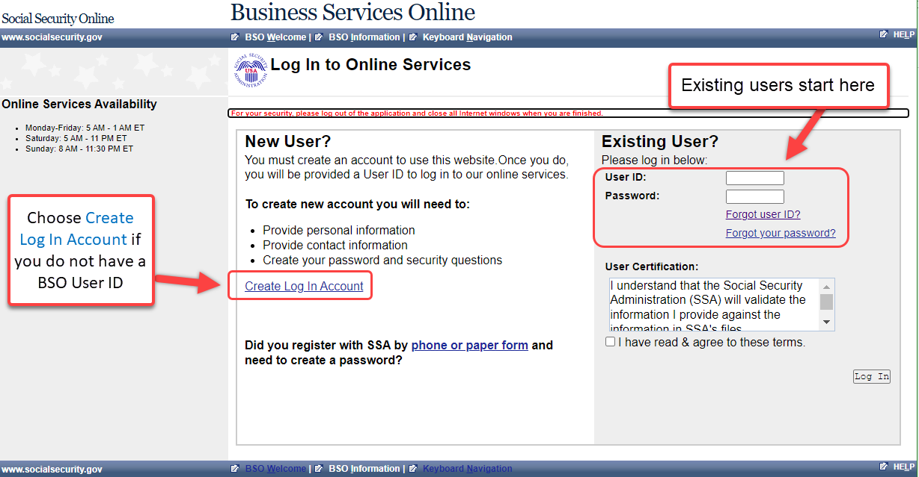
Log into Business Services Online (BSO)
Step 2:

Slide 8
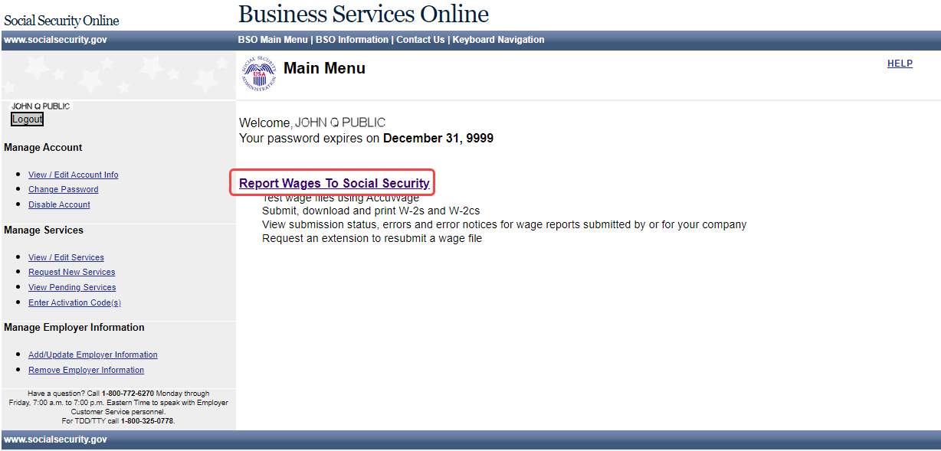
Select Report Wages to Social Security
Step 3:

Slide 9
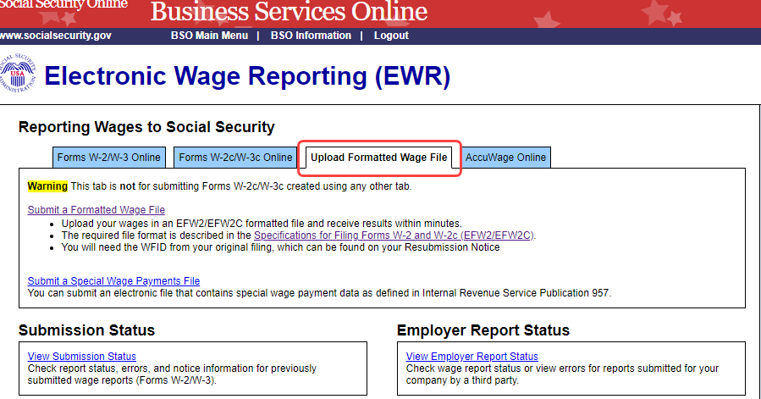
Select Upload Formatted Wage File Tab
Step 4:
Note: Forms W-2/W-3 Online allows you to key up to 50 W-2s directly into SSA’s wage processing system.
Forms W-2c/W-3c Online allows you to key up to 25 W-2cs directly into SSA’s wage processing system.
AccuWage Online is software that lets you check your EFW2 or EFW2C formatted file for most error conditions prior to uploading it.

Slide 10
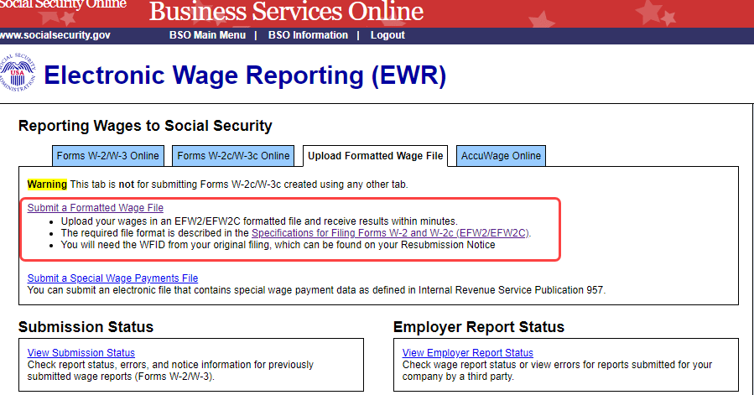
Select the Submit a Formatted Wage File link
Step 5:

Slide 11
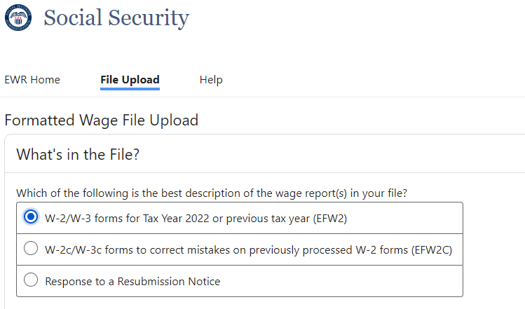
Select your file’s format (W-2 or W-2c)
Or select “Response to a resubmission Notice” if you received a Resubmission Notice and are resubmitting a file
Step 6:

Slide 12
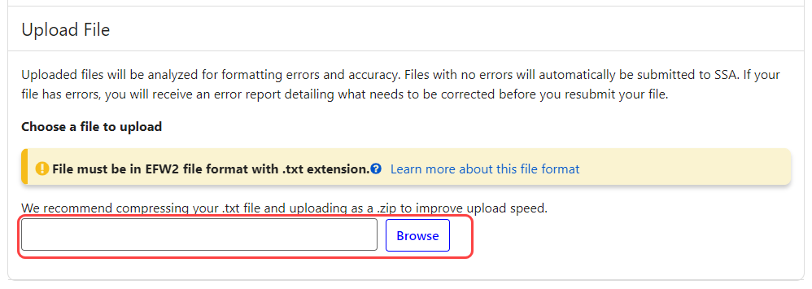
Step 7:
Use the Browse box to choose a file to upload
Use the Browse function on your computer to choose the file you want to upload

Slide 13
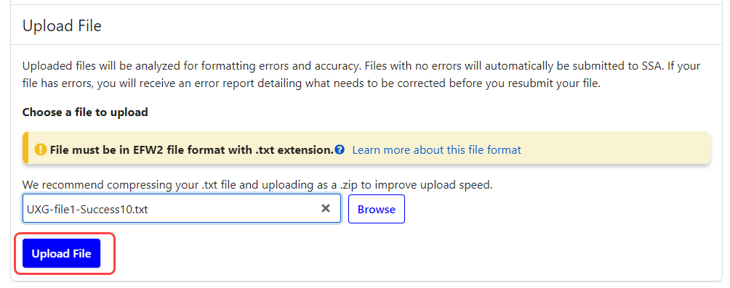
After the name of your file appears in the box next to Browse, then select the Upload File box
Step 8:

Slide 14


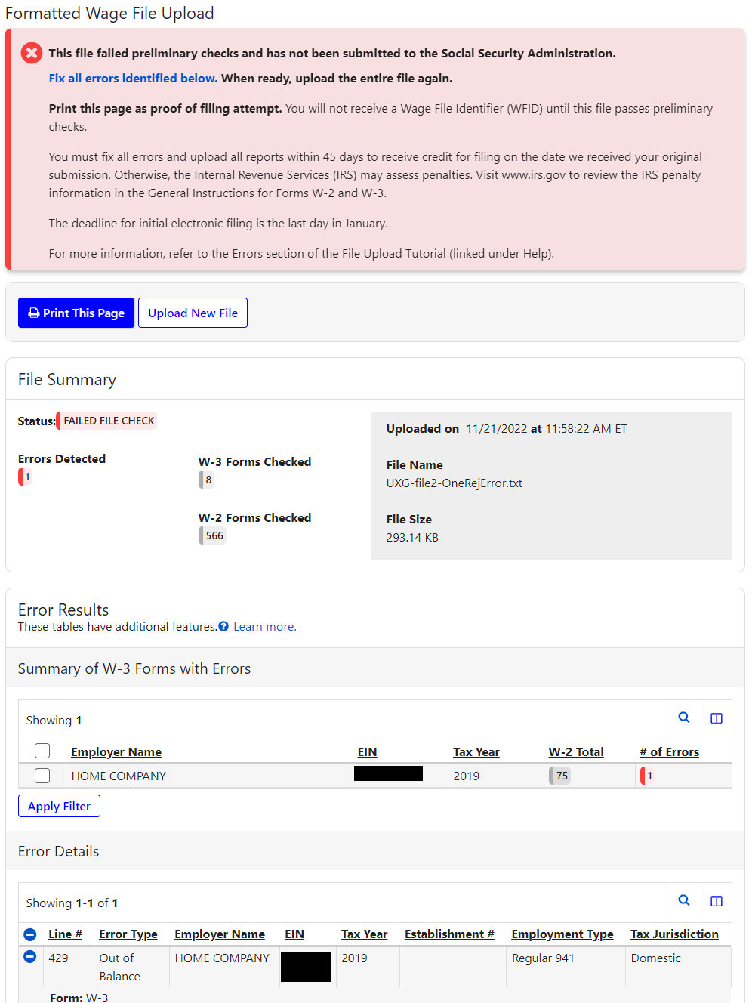
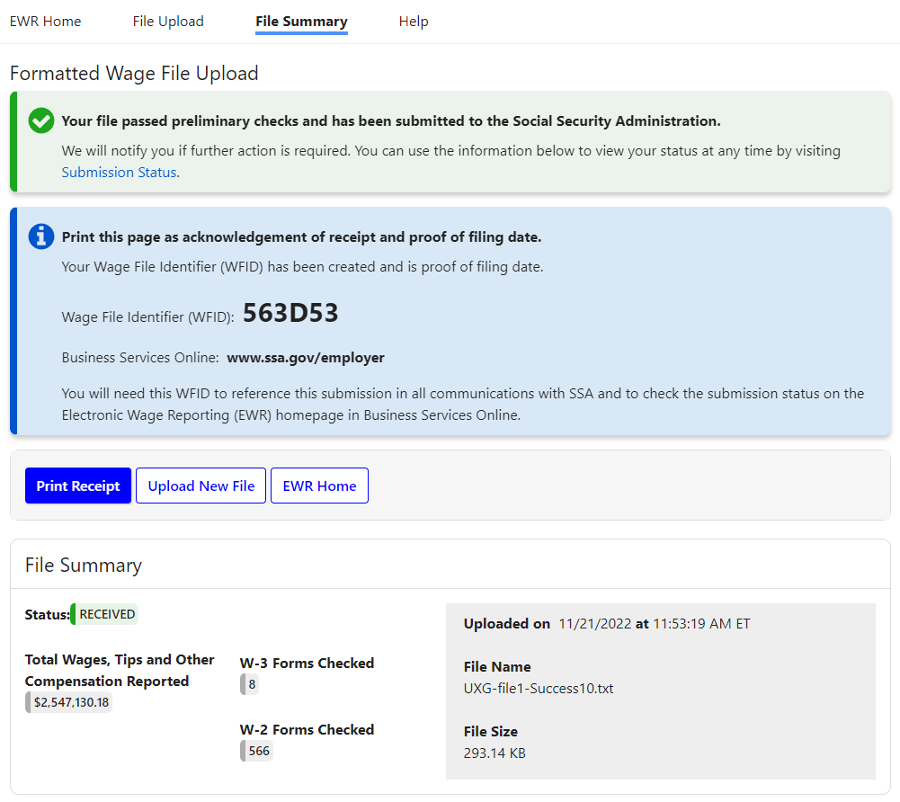
You will receive one of two results:
You Have Errors
Successful Upload

Slide 15
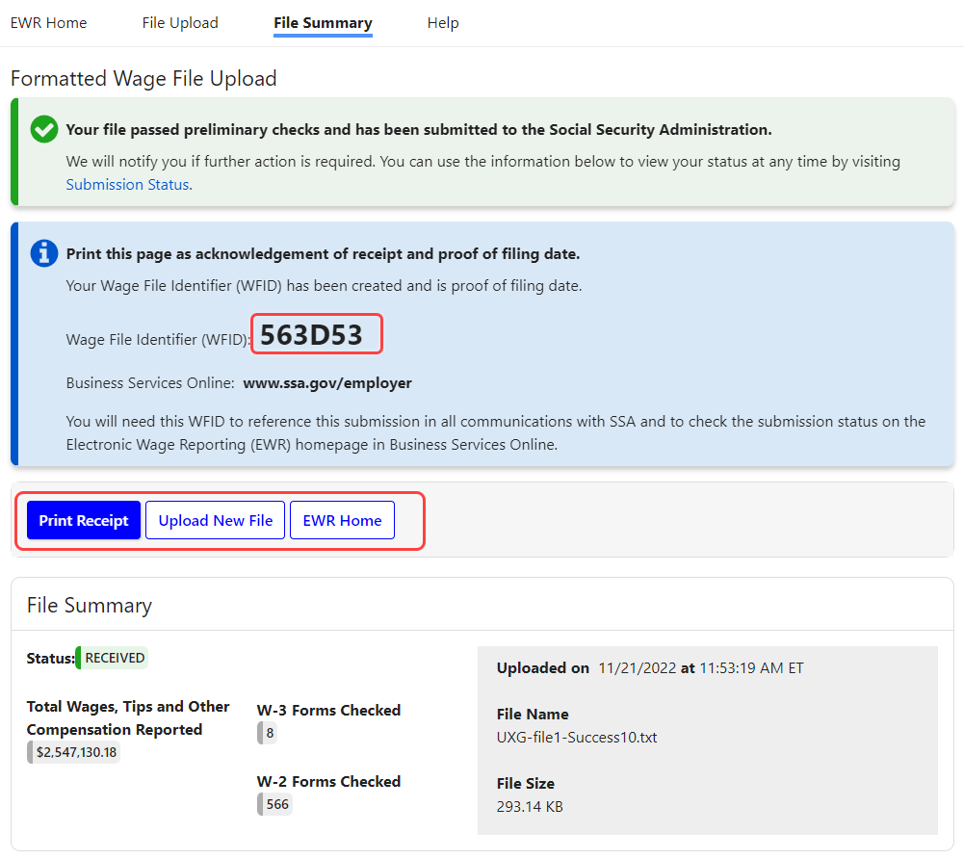
Successful Upload
Confirmation page for a successful upload includes:
Results in less than 60 seconds
Wage File Identifier (WFID – SSA’s tracking code)
File Summary with details of upload

Slide 16
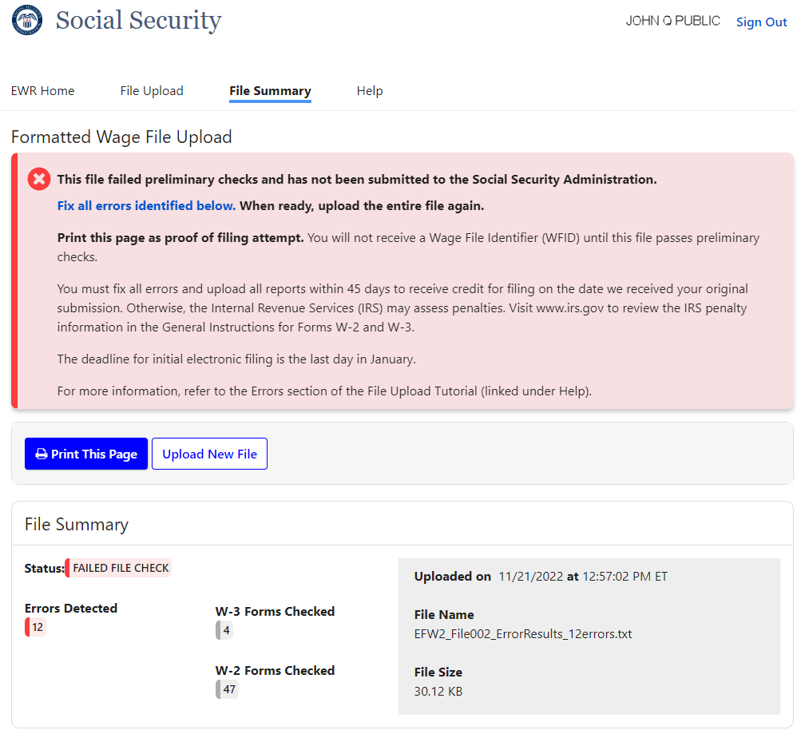
You Have Errors
(1 of 5 pages)
SSA will reject your file and all reports in that file if there are any errors.
You will NOT get a Wage File Identifier (WFID) if you have errors in your file.
You will need to fix the errors in your file and upload the fixed file.
Summary information about your file is displayed here.
Detailed error information continues on the following PowerPoint slides. On the actual web page you will just continue to scroll down
Notes:
.

Slide 17
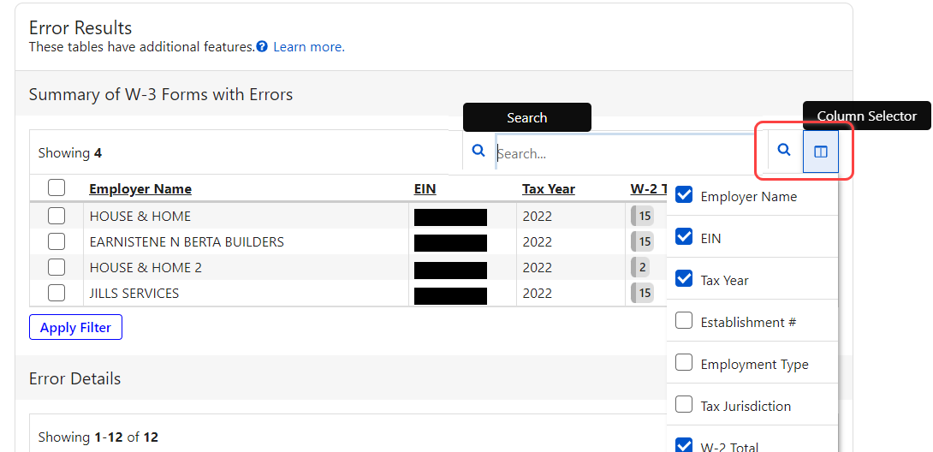
You Have Errors (2 of 5 pages )
Search icon filters the table by a specific string of characters in any column of the table.
Column Selector to select the columns you want to display in the table.

Slide 18
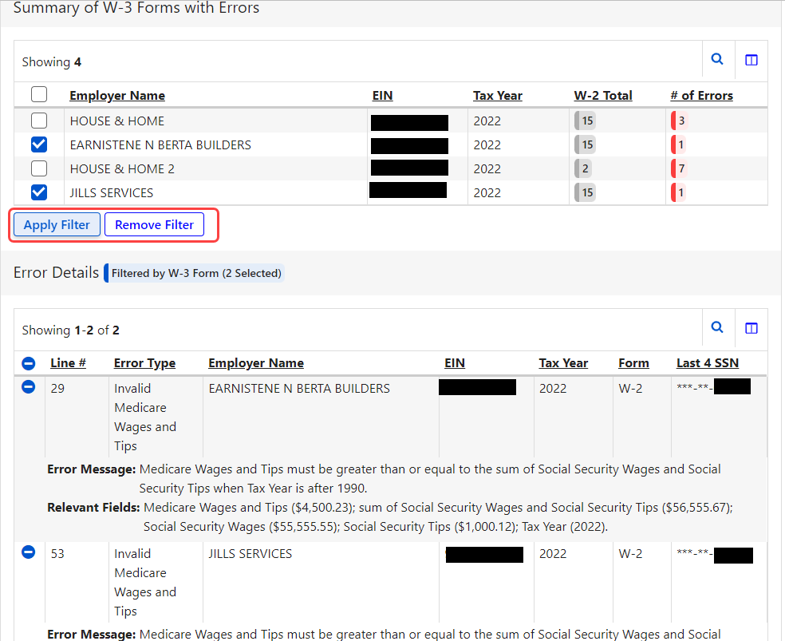
You Have Errors (3 of 5 pages)
You can filter errors by:
      Employer Name
      EIN
      Tax Year
      Tax Jurisdiction
      Establishment #
      # of Errors
      W-2 Total
      Employment Type

Slide 19
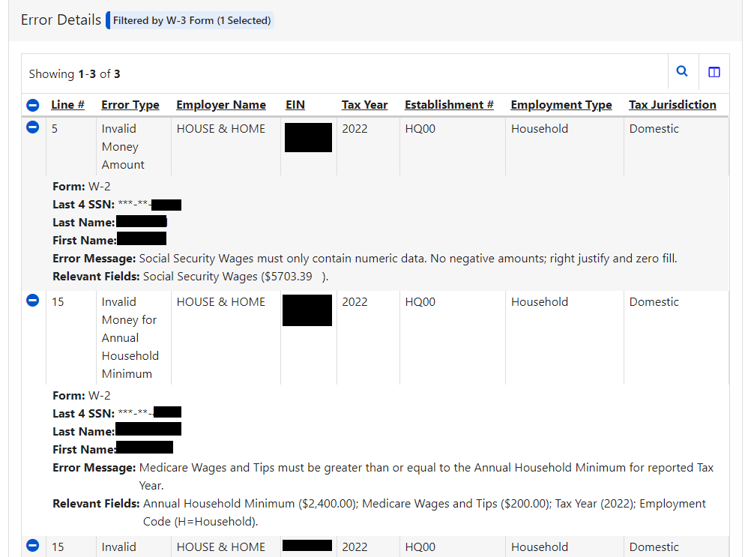
You Have Errors (4 of 5 pages)
You will immediately see specific details about your errors, including the line number in your file.

Slide 20
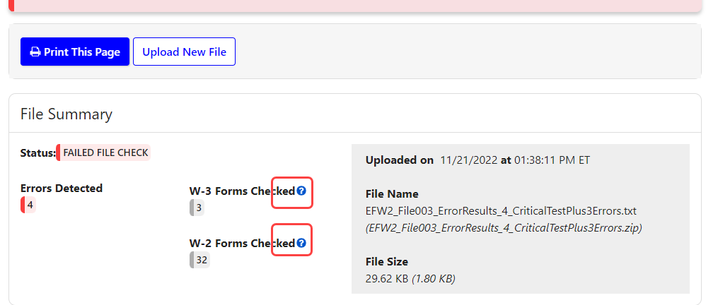
You Have Errors (5 of 5 pages)
Context sensitive Help links are now located on the page

Slide 21
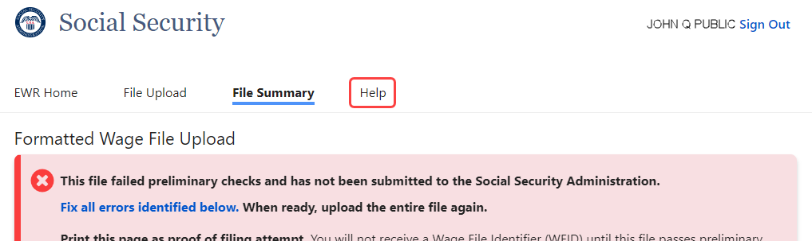
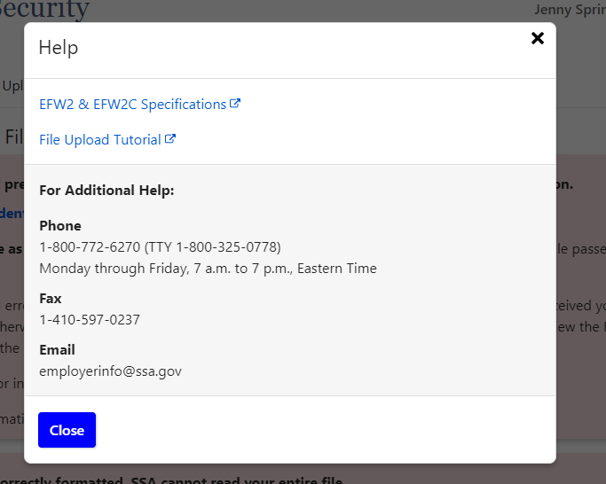
The Help link
at the top provides links to manuals and contact information.

Slide 22
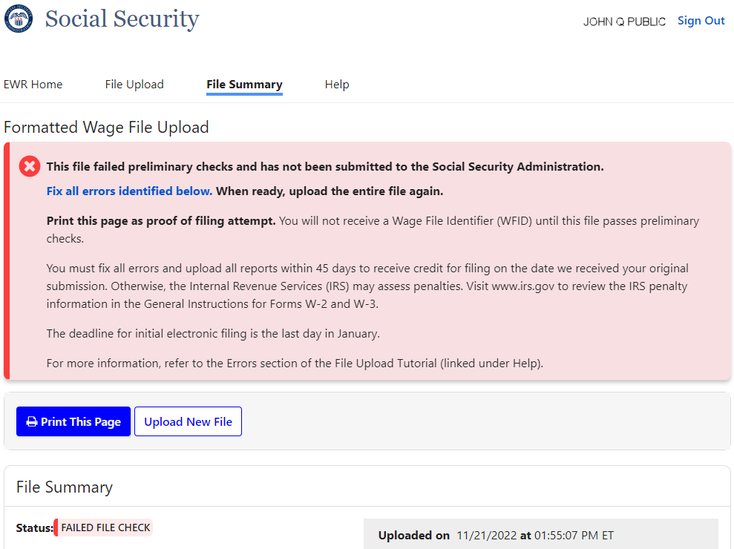
Proof that you uploaded a file even though it didn’t get a WFID
You will not receive a Wage File Identifier (WFID) if any reports in your file has errors.
Fix the error(s) and return all reports again.
Print This Page for your records to show you uploaded your file.
You have the option to split your file and submit the good reports while fixing reports with errors

Slide 23
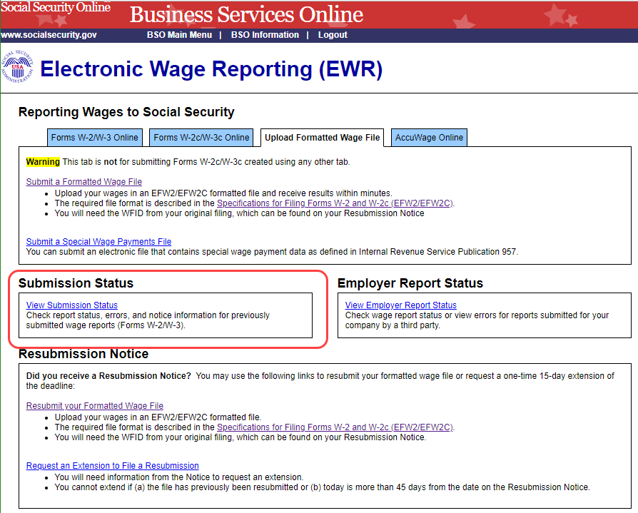
If your file is returned due to our back-end checks (1 of 2 pages)
Even though your file passed our online checks, and you received a WFID, if a report fails to pass our back-end checks, SSA will notify you within a day or two and reject your file.
Then, you will need to log into BSO after you receive a resubmission notice to learn more about the error.

Slide 24
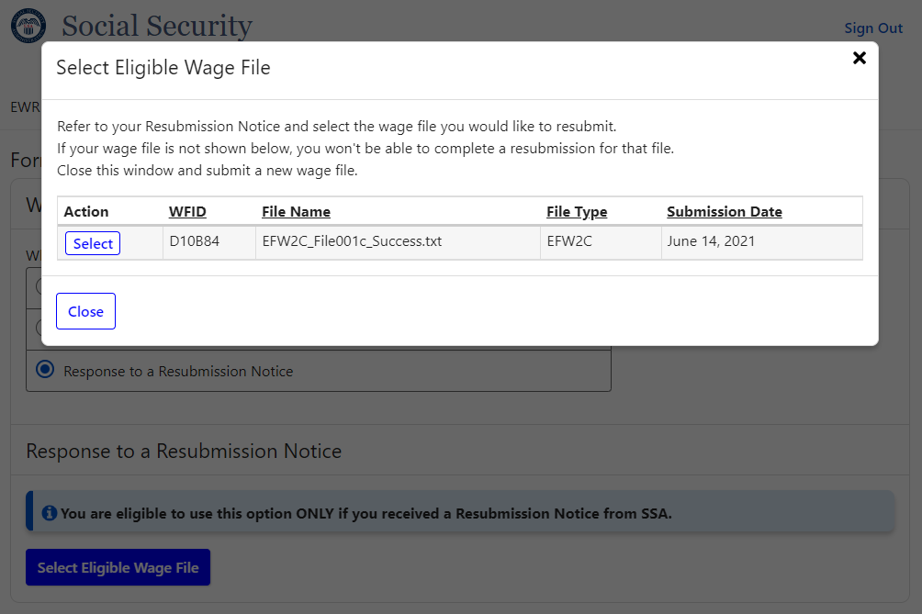
If your file is returned due to our back-end checks (2 of 2 pages)
Once you fix the problem, you have 2 options to return the file to SSA.
    You may select the “Response to a Resubmission Notice” on the “What’s in the File” page. You will be able to select the old WFID and then upload the file. You will receive a success confirmation (with the same WFID) or a list of errors.
    Even though you already have a WFID, you may upload the file as a new file. You will get a new WFID if your file has no other errors.
In either case, as long as you upload the file within 30 days SSA will consider your file uploaded timely.

Slide 25
Reminders
Remember to include a valid file extension, either .txt or .zip.
  The zip file must contain only one .txt file
If you use screen scraping, you will need to make sure your routine matches the screen path, which was changed in December 2021. The old system will be unavailable as of December 2022.
For detailed information please review the Tutorial.

Slide 26

That’s all there is with the Wage File Upload.
Information about your file in real-time.
No reason to come back unless your file is rejected.
You can still log into BSO and view information on all of your files and reports.
This is the end of the Wage File Upload slides. Other topics on the following pages.

Slide 27
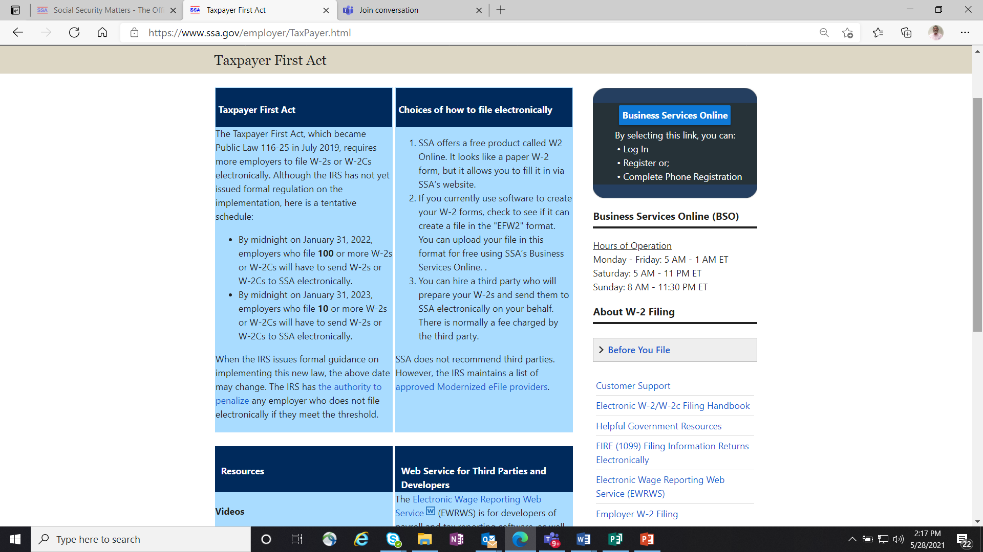
Lowering of the electronic reporting threshold
Taxpayer First Act
(1 of 2 pages)
Taxpayer First Act mandates electronic filing of many IRS forms including W-2s.
In 2022* if you send 100 or more W-2s to SSA, you must file them electronically.
In 2023* that limit is lowered to 10.
Year | Threshold lowered to
2022 | 100*
2023 | 10*
* These dates are tentative. SSA will finalize dates once IRS issues final regulations. Initial Federal Register announcement posted on 7/23/2021 .

Slide 28
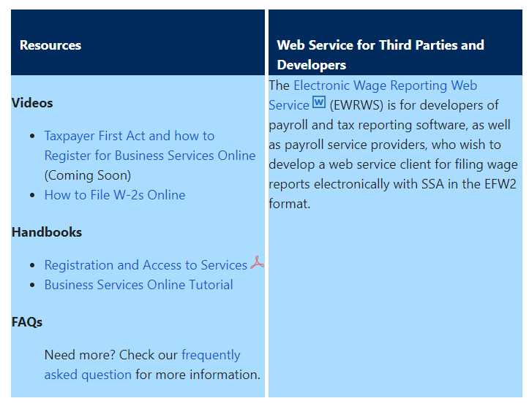
Lowering of the electronic reporting threshold
Taxpayer First Act
(2 of 2 pages)
See SSA’s Taxpayer First Act page for more information including options to file for free
IRS Electronic-Filing Requirements for Specified Returns and Other Documents

Slide 29
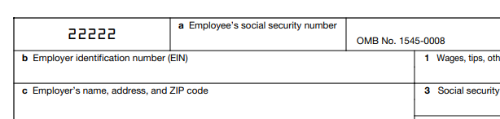
Truncated Social Security Number (SSN)
XXX-XX-1234
You may truncate the SSN on
recipients’ W-2s.
SSA will not accept truncated SSNs that only show the last four digits (XXX-XX-1234) on W-2 Copy A (sent to SSA) or in the SSN field of the EFW2 formatted wage file.
Please remember to show all nine digits of the SSN on Copy A to ensure proper paper processing.
Please check each State’s requirements for displaying an SSN and if they allow truncation for W-2s sent to a state.

Slide 30

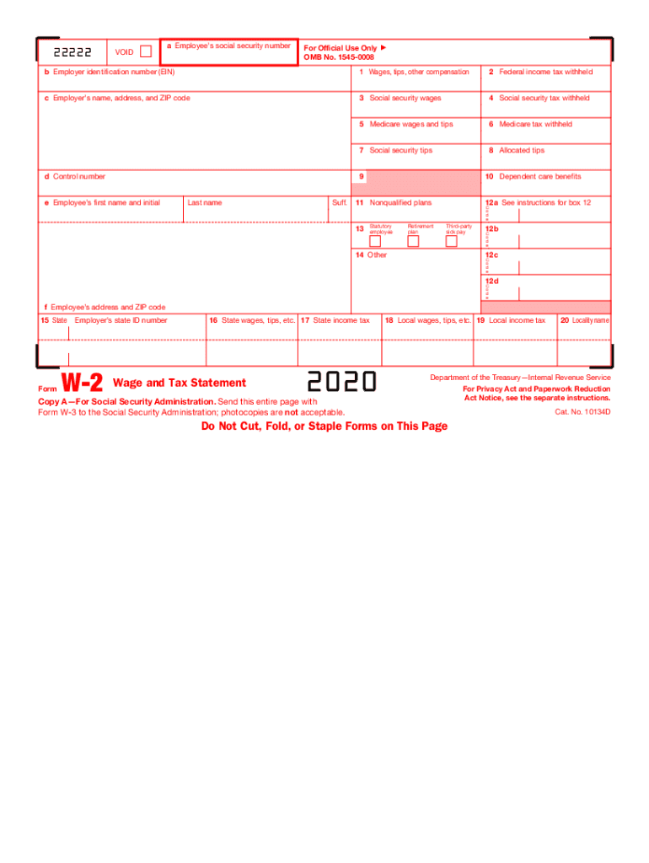
W-2 Online is a free service from SSA
Looks just like a paper W-2, but it’s on SSA’s website
Key up to 50 W-2s for FREE!
Register for Business Services Online
SSA also offers W-2C Online!
For more information, see the W-2 Online tutorial
1

Slide 31

If your software creates a file, consider
Wage File Upload
Does your software create a W-2 file in the EFW2 format?
If yes, you can upload your file to SSA to process for free.
Register for Business Services Online.
For more information see the Wage File Upload tutorial.
Ask your software provider if their software provides an EFW2 file.

Slide 32
What else is new?
What's New for 2023
New Features to the W-2/W-2c Online Applications
SSA will publish these changes in November 2022

Slide 33
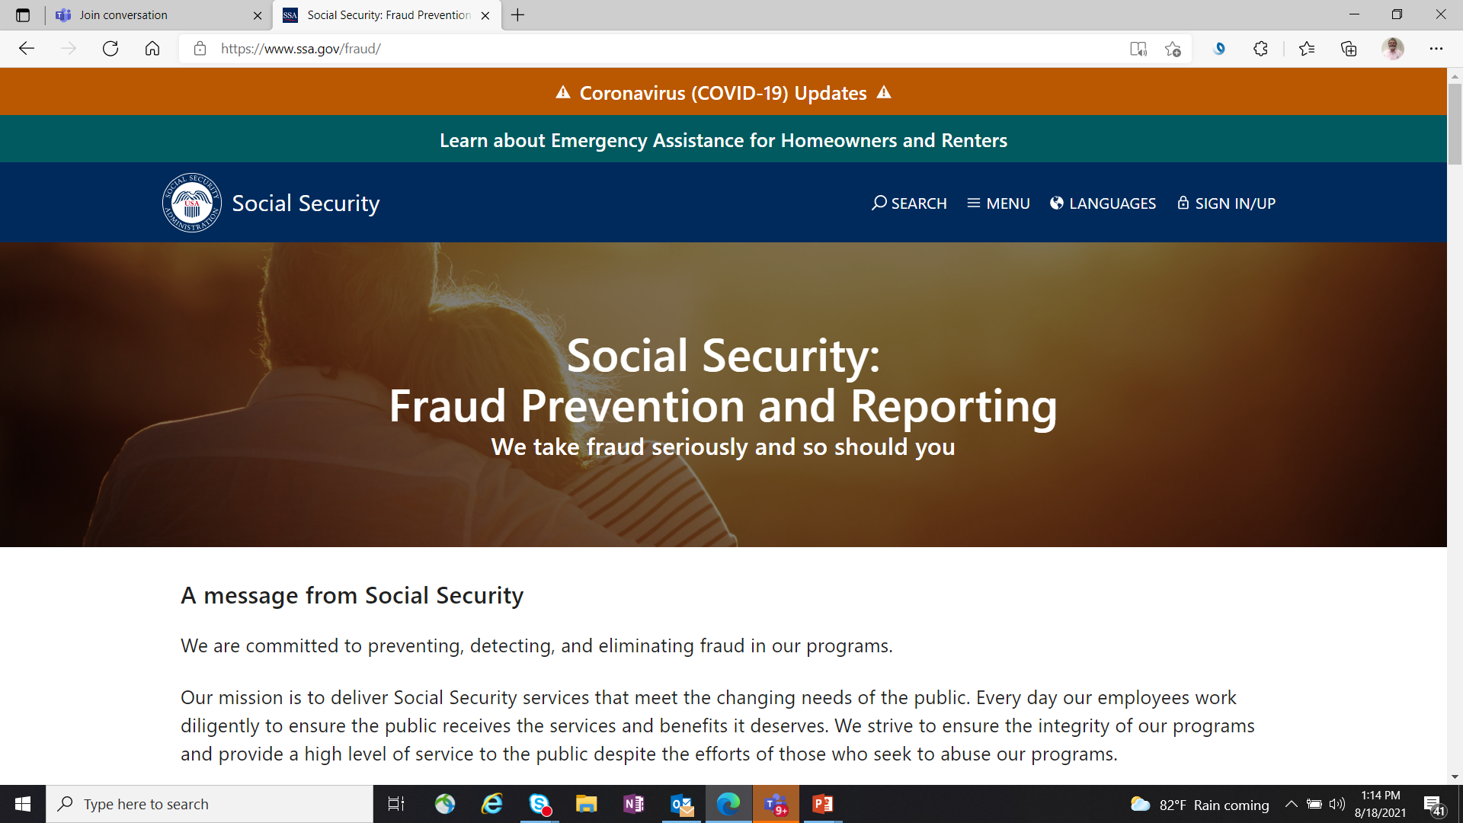
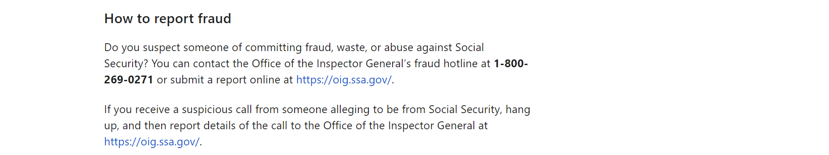
Social Security: Fraud Prevention and Reporting

Slide 34
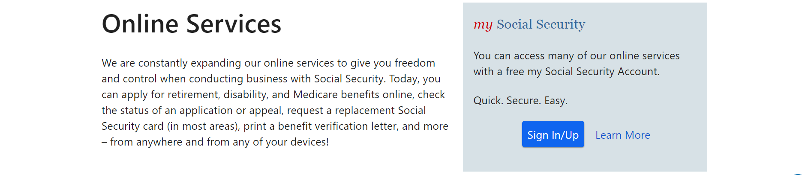
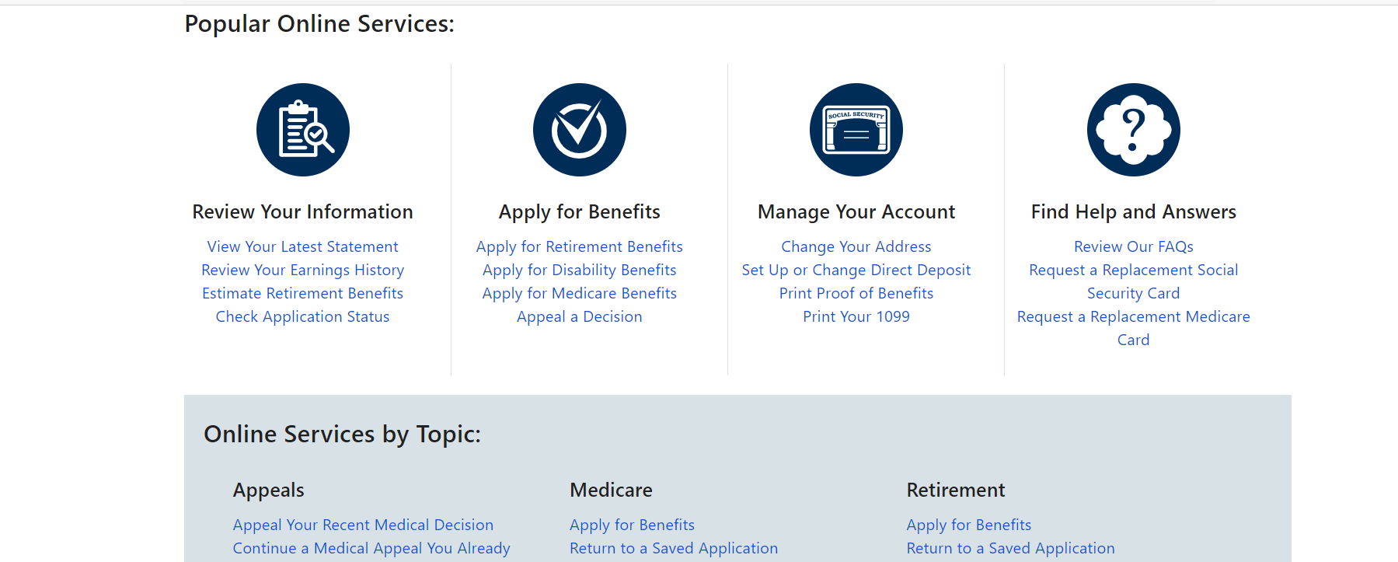

Slide 35
Find helpful online Wage Reporting information
Go to the Employer Page for videos, tutorials, and other useful information and links.
Employer W-2 Filing Instructions & Information (ssa.gov)
What’s New for 2023
    SSA plans to activate the URL for the “What’s New for 2023” page before the end of November 2022.
IRS W-2 information
IRS Publication 15, (Circular E), Employer's Tax Guide

Slide 36
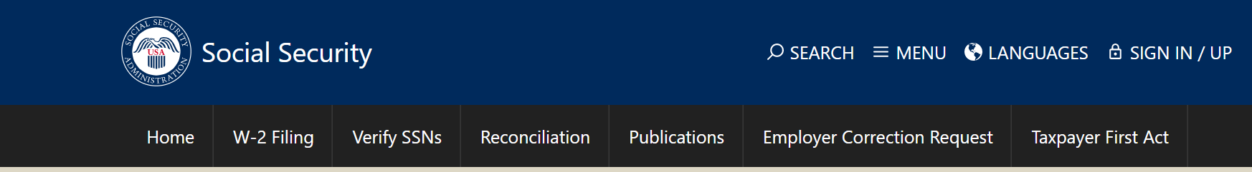
What’s New for 2021
Thank you for viewing this training package.
This is the end of this training package.

