Slide 1

Direct Fee Payment to Representatives and Forms IRS 1099-MISC and 1099-NEC
Information for the 2020 and subsequent tax years

Slide 2
Introduction
We are required to provide taxpayer information to the IRS for direct fee payments made to representatives of claimants for Social Security and Supplemental Security Income benefits.
www.ssa.gov

Slide 3
Receiving an Authorized Fee Directly-Paid
To receive your authorized fee directly paid from a claimant’s past-due benefits, you must be eligible for, and request, direct payment.
You must also be registered with us.
www.ssa.gov

Slide 4
Registration Requirements
You must be registered before requesting direct payment.
To register, you need to complete and submit Form SSA-1699, Registration for Appointed Representative Services and Direct Payment.
This is a one-time registration. However, if your information changes (e.g., name, address, business affiliation), you must submit an updated form each time you need to report a change.
www.ssa.gov

Slide 5
When Registration is Required
You do not need to complete Form SSA-1699 if you are:
Assisting a claimant with simple tasks as a translator, a relative or friend or other acquaintance.
Appointed to perform representational services but will not seek a fee, or you will seek a fee but not direct payment.
www.ssa.gov

Slide 6
How to Register via Form SSA-1699
Complete a fillable Form SSA-1699 online.
Print, date and sign the form.
Fax to 1-877-268-3827.
www.ssa.gov

Slide 7
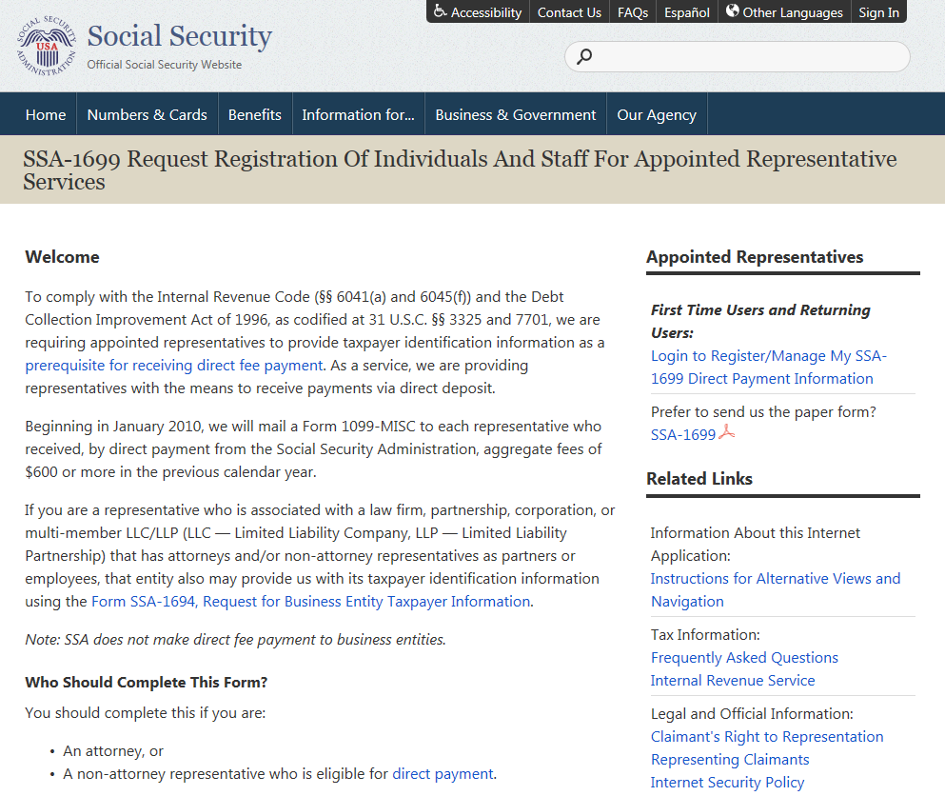
Where to Find Information about Form SSA-1699

Slide 8
Information for Direct Fee Payment in Each Case
For each case to which you are appointed, seek a fee and direct payment of the authorized fee, you must submit section 5 of the new version SSA-1696 Claimant’s Appointment of a Representative when competing the appointment.
  If, in a specific case, you previously submitted a notice of appointment and did not seek a fee, but you are now, you need only provide this section.
  If you are waiving your fee or direct payment, you do not need to complete this section.
  You must do so even if you are a court attorney who was not or will not be appointed on the claim at the administrative level.
www.ssa.gov
Notes:
Add link

Slide 9
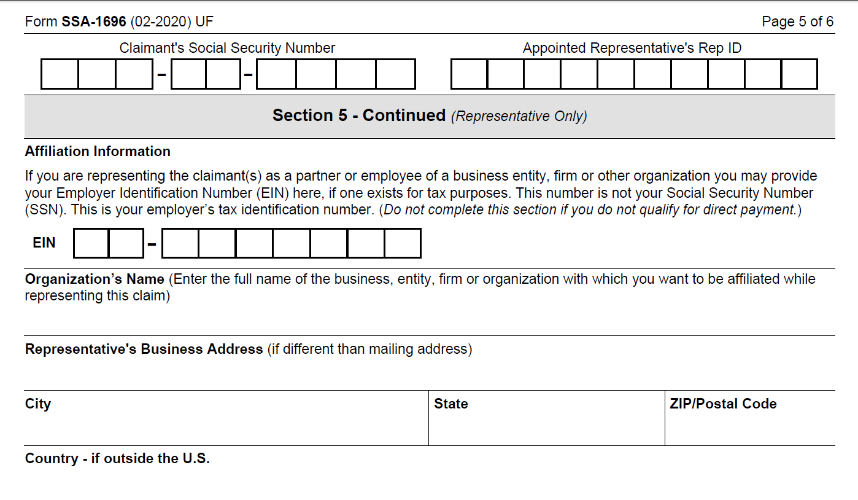
Form SSA-1696 Affiliation and Payment Information
www.ssa.gov

Slide 10
Entities
We do not recognize entities as appointed representatives or make direct payments to entities, such as firms or organizations. We pay only individuals.
Entities that employ representatives can register voluntarily using Form SSA-1694, Request for Business Entity Taxpayer Information, to receive a Form IRS 1099-NEC to assist them in fee reconciliation.
This is a one-time registration, but the entity and employee- representative are responsible for informing us about updates regarding their information and employment via Form SSA-1694.
www.ssa.gov

Slide 11
Entities
Entities (or representatives on behalf of their employers) can complete and submit SSA-1694, Request for Business Entity Taxpayer Information, online or on paper by completing and printing the fillable template and either faxing to 1-877-268-3827, or delivering it in-person.
www.ssa.gov

Slide 12
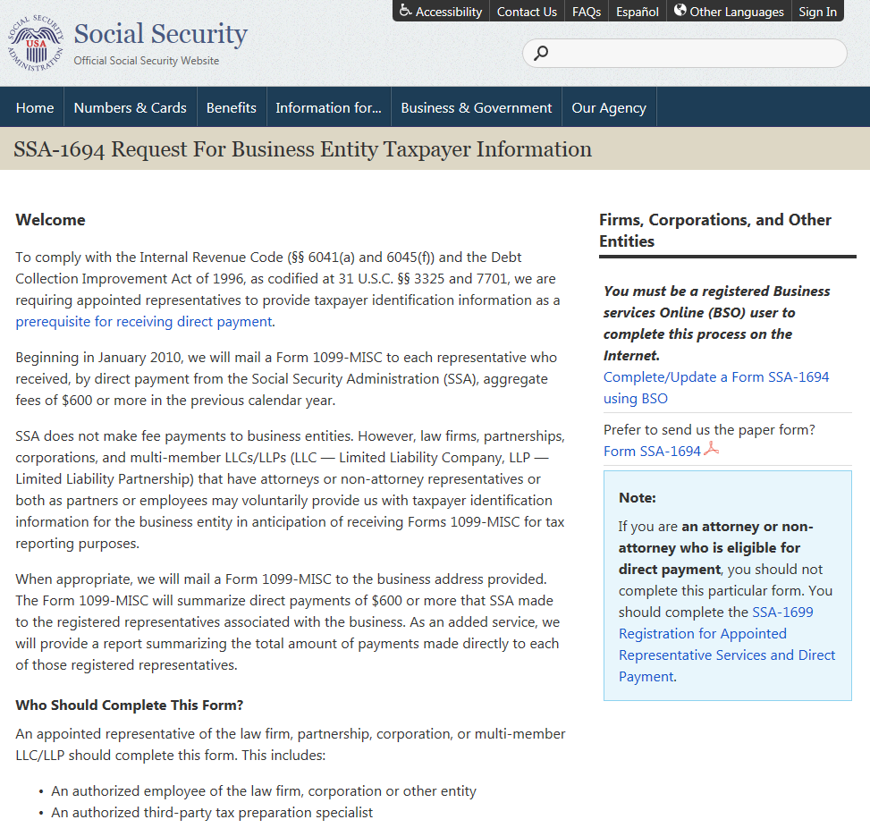
Where to Find Information about Form SSA-1694

Slide 13
Forms IRS 1099-MISC and 1099-NEC
We are required to issue a Form 1099-MISC or Form 1099-NEC to claimant representatives to whom we paid aggregate fees of $600 or more in a calendar year.
When representatives affiliate with an entity or firm on Section 5 of the Form SSA-1696, we send a separate Form 1099 to the entity to assist the entity/employer and its representative/employee in reconciling payments in their books.
www.ssa.gov

Slide 14
Form IRS 1099-MISC
We send Form 1099-MISC to representatives whom we paid directly and who were identified in our records as employees of a registered entity or firm.
We report these earnings in Box 10 (Previously the earnings were reported in Box 14).
Amounts in Box 10 are not reported as income to the IRS.
www.ssa.gov

Slide 15
Form IRS 1099-NEC
We send Form 1099-NEC to representatives whom we paid directly and who were identified in our records as sole proprietors and to registered entities.
We report these earnings in Box 1 “Nonemployee compensation” (Note: Until 2019, these were reported in Box 7 of the IRS 1099-MISC).
These amounts are reported to the IRS as income.
www.ssa.gov

Slide 16
Form SSA-1694
When an entity (employer) registers with us via Form SSA-1694, we send a Form 1099-NEC to the entity with all direct payments made to all representatives affiliated with the entity.
The total amount will be in Box 1 (“Nonemployee compensation”).
www.ssa.gov

Slide 17
Assessment or “User Fee”
The law requires us to charge a user fee to cover some administrative costs when we make a direct payment to claimant representatives.
We deduct this user fee from the amount payable to the representative. Representatives cannot collect this expense from the claimants.
The amount reported on IRS Forms 1099-MISC and 1099-NEC is the gross amount (before the user fee).
See SSA Policy Manual GN 03920.019, Assessment on Representatives Who Receive Direct Payment.
www.ssa.gov

Slide 18
Corrections to Forms 1099-NEC and 1099-MISC
Representatives are responsible for updating their personal information and affiliations. We will only correct a Form 1099-NEC or Form 1099-MISC to account for the following:
Name or address changes;
Remittances of payments made the same calendar year but not properly posted; or
Non-receipt of fees posted to 1099-NEC.
www.ssa.gov

Slide 19
Corrections continued
We do not correct a Form 1099-NEC or Form 1099-MISC to reflect remittances of payments made prior to the calendar year, or errors that occurred due to incorrect affiliations.
In such instances, the representative must contact the IRS or his or her employer to initiate corrections.
www.ssa.gov

Slide 20
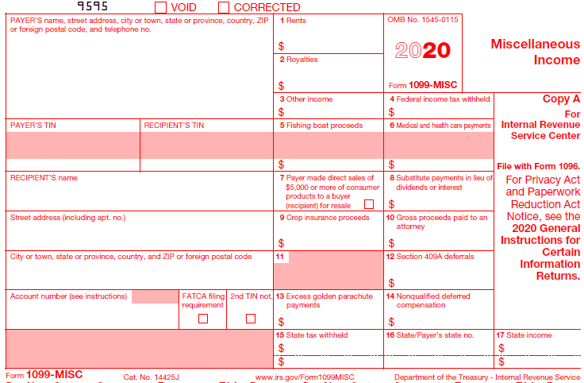
Understanding Form 1099-MISC
(Informational Form for the individual Representatives)
1. PAYER’S TIN: Social Security’s EIN.
2. RECIPIENT’S TIN: Taxpayer’s Tax Identification Number/Your SSN.
3. Box 10 – Gross proceeds paid to an attorney
The amount we paid you directly when you were identified in our records as an employee of an entity that was registered using Form SSA-1694. You do not need to report this amount as income to the IRS.
1
2
3

Slide 21
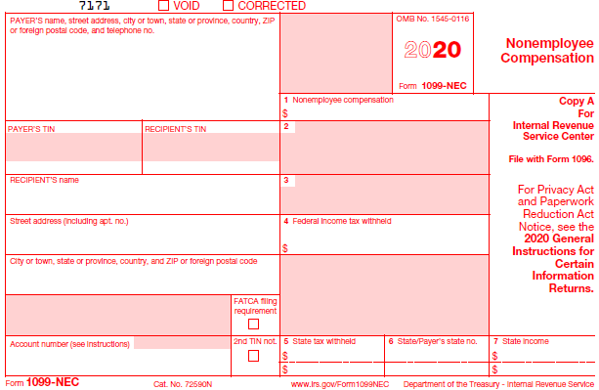
Understanding Form 1099-NEC
1. PAYER’S TIN: Social Security’s EIN.
2. RECIPIENT’S TIN: Taxpayer’s Tax Identification Number/your SSN.
3. Box 1 – Nonemployee compensation
The amount we paid you directly in the tax year (or last calendar year) when you were identified in our records as a(n)
sole proprietor (showing the amount we paid you in the tax year), or
entity or firm (showing the amount we paid all your employees in the tax year), or
employee of an entity (showing the amount we paid the employee in the tax year) when the entity is not registered by December 31st (and the deadline has passed and can no longer register for the previous tax year), or the employee was not correctly affiliated with the entity.
The deadline to register your entity each year is December 31st. Individuals who receive a Form 1099-MISC with amounts that actually belong to another person or to a firm should see general instructions for this situation on the IRS website.
3
1
2

Slide 22
Incomplete or discrepant data
If the amount on your Form 1099-NEC or Form 1099-MISC is incomplete, you must use your own accounting records to supplement the information on income you report to the IRS.
If you believe the amounts on your Form 1099-NEC belong to another person or firm, refer to the General Instructions for Certain Information Returns on the IRS.gov website for this situation. Specific instructions are on page 3 in Section A. (Who Must File - Nominee/middleman returns) of these instructions.
www.ssa.gov

Slide 23
Getting Help
Contact your local Social Security office if there is a discrepancy between the amount on your Form 1099-MISC and actual amount due to a remittance, returned check or non-receipt of a fee.
You can also contact our Representative Call Center toll-free at 1-877-626-6363.
www.ssa.gov

Slide 24
FAQs
Question
Why did I receive Form 1099-MISC but my employer received a Form 1099-NEC?
Answer
The IRS revised Form 1099-MISC and developed Form 1099-NEC. The changes are effective starting January 1, 2021 for income received in calendar year 2020.
We issued you a Form 1099-MISC because you were identified in our records as being affiliated with your employer. This income will be reported in Box 10 and will not be reported as your income to the IRS. The income reported on your employer’s Form 1099-NEC in Box 1 will be reported as your employer’s income to the IRS.
www.ssa.gov

Slide 25
FAQs
Question
Why is my Social Security number on Form 1099-MISC or Form 1099-NEC?
Answer
The Internal Revenue Service (IRS) requires that we use your Social Security number to identify you. Your Social Security number will always appear on the Form 1099-MISC.
If you are a sole proprietor and have an Employer Identification Number (EIN), your Social Security number will appear in the Recipient’s Identification Number box, and your EIN will appear in the Account Number box. If you do not have an EIN, only your SSN will appear.
If you work for a firm or organization, your Social Security number will appear in the Recipient’s Identification Number block, and the EIN for the firm will appear in the Account Number box.
www.ssa.gov

Slide 26
FAQs
Question
Why did I receive more than Form 1099-MISC?
Answer
You receive a separate Form 1099-MISC for yourself, and for every firm or organization with which you registered, but only if you have received aggregate payments of $600 or more in a year.
www.ssa.gov

Slide 27
FAQs
Question
I made more money than Form 1099-MISC reflects. How can I get the money amount corrected and the payments annotated?
Answer
If your Form 1099-MISC is incomplete, you must use your own accounting records to supplement the information on the form when reporting your income you report to the IRS.
www.ssa.gov

Slide 28
FAQs
Question
Should a firm or organization complete a Form SSA-1694, Request for Business Entity Taxpayer Information, on behalf of each representative in the firm?
Answer
No. Each firm should complete Form SSA-1694 once for the employer identification number (EIN). If the firm has multiple EINs, all EINs must be registered.
www.ssa.gov

Slide 29
FAQs
Question
Where should I send my completed Form SSA-1694, Request for Business Entity Taxpayer Information?
Answer
We suggest you file Form SSA-1694 online at www.ssa.gov. However, you can also fax it or submit it to your local Social Security office.
www.ssa.gov

Slide 30
FAQs
Question
Do I need to file a Form SSA-1694, Request for Business Entity Taxpayer Information, every year?
Answer
No. This is a one-time registration for each entity you affiliate with. File a Form SSA-1694 only once to register your employer (firm, organization), or your sole proprietor’s Employer Identification Number (EIN), or to correct/change an existing EIN.
www.ssa.gov

