Slide 1
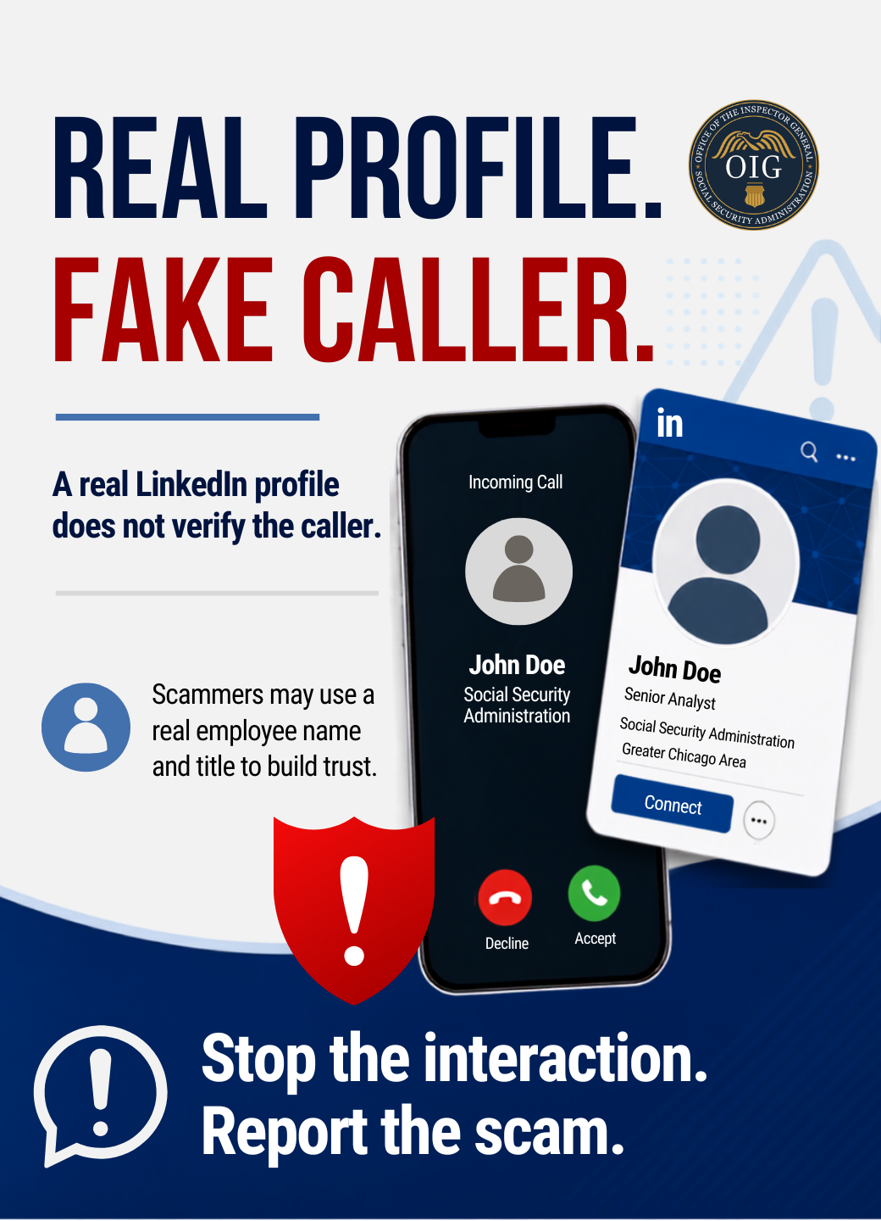
A real employee profile does not prove the caller is legitimate. Scammers may use real names and titles to build trust. If there is pressure, a threat, or a money request, stop and report it.
More info: ssa.gov/scam
#SlamTheScam #ScamAwareness #FraudPrevention

Slide 2
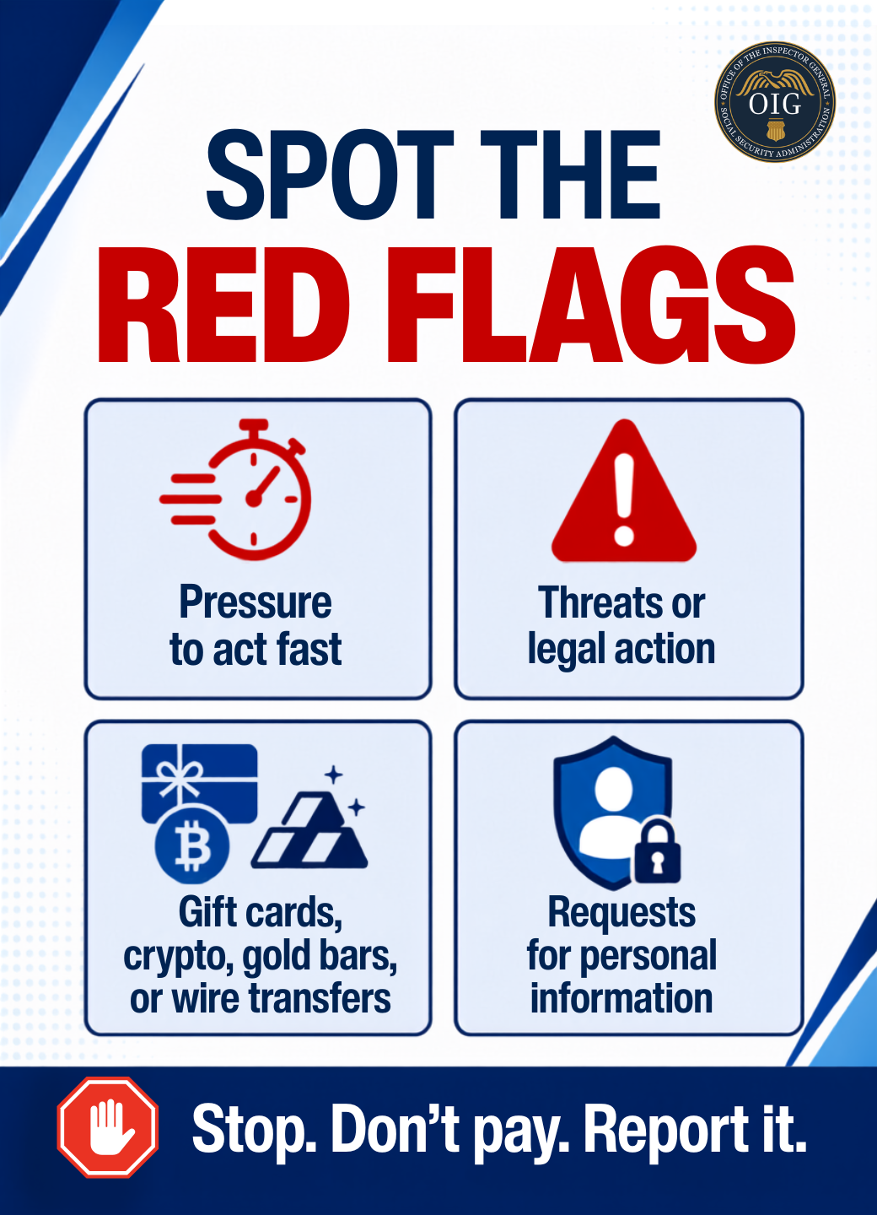
Pressure, threats, unusual payment requests, and requests for personal information are red flags. Those tactics point to a scam, not a real government contact.
Know the signs: ssa.gov/scam
#SlamTheScam #ScamAwareness #FraudPrevention

Slide 3
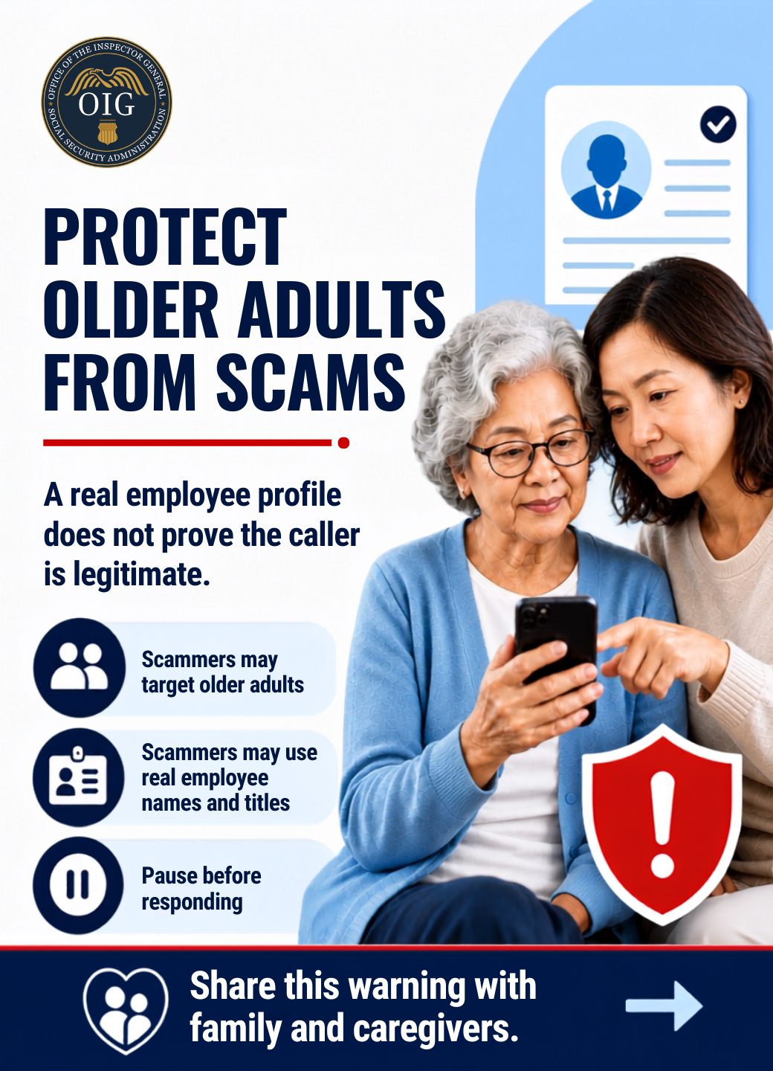
Help protect older adults from scams. A real employee name or profile can be used to build false trust. Pause, verify, and share the warning with caregivers.
More info: ssa.gov/scam
#SlamTheScam #ScamAwareness #FraudPrevention

Slide 4
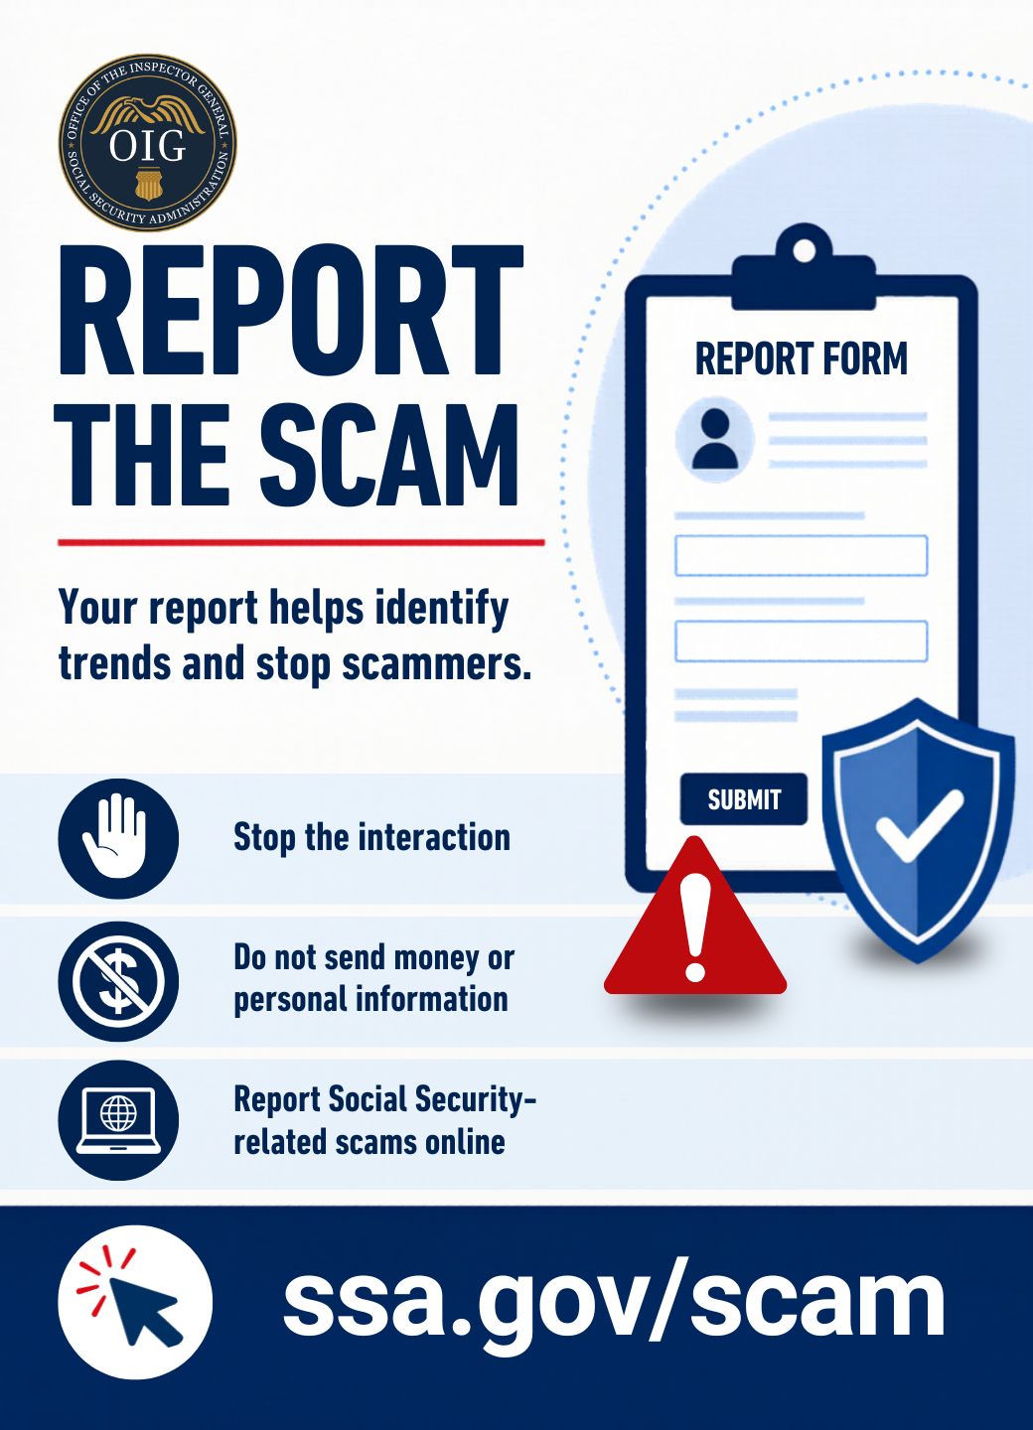
Stop the interaction. Do not send money. Do not share personal information. Report suspicious Social Security-related scams online at ssa.gov/scam
#SlamTheScam #ScamAwareness #FraudPrevention

