Slide 1
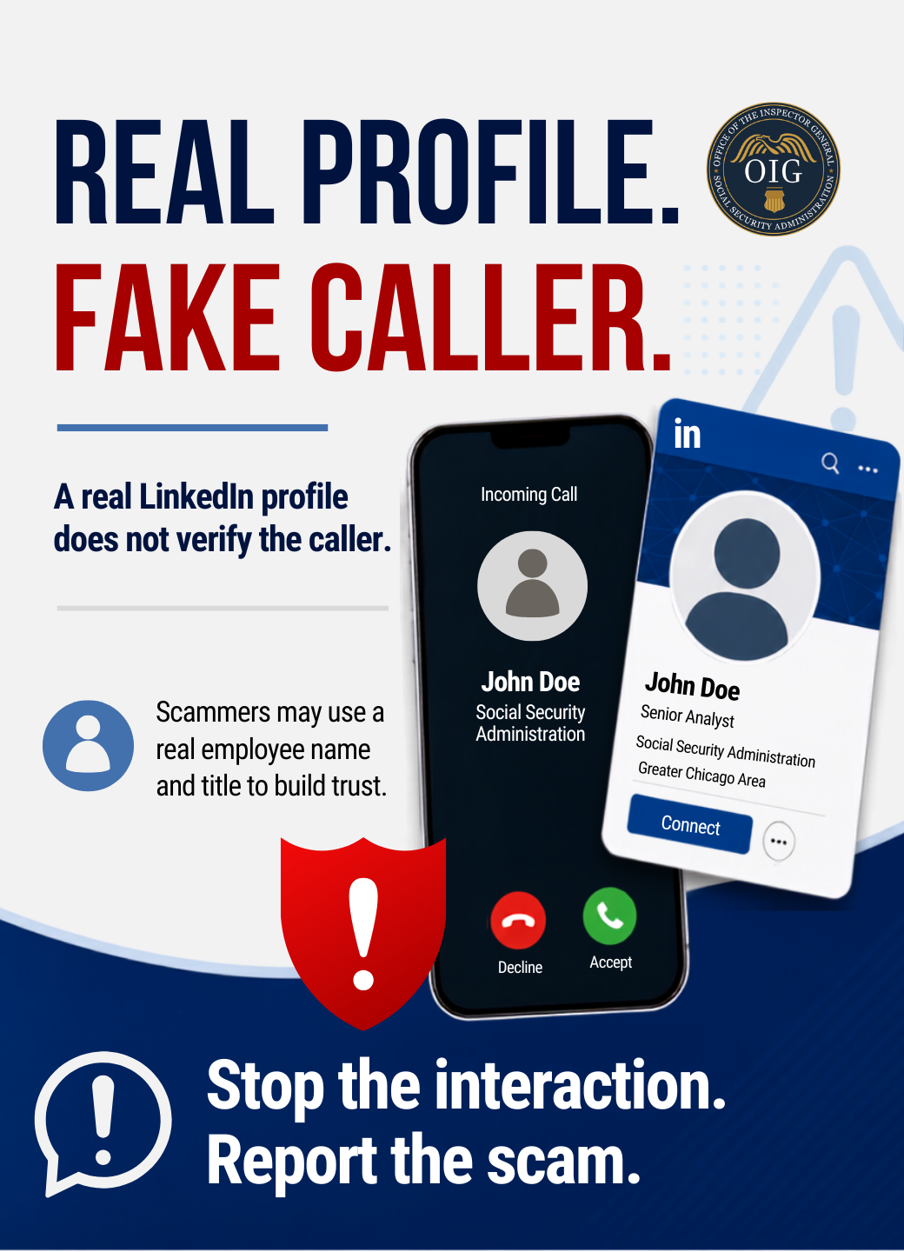
A real employee profile does not verify the caller. Scammers may use a real SSA employee name, title, or public profile to make a Social Security-related contact seem legitimate. If there is pressure, a threat, or a request for money or personal information, stop the interaction and verify through official channels.
Report and learn more at ssa.gov/scam
#SlamTheScam #ScamAwareness #FraudPrevention

Slide 2
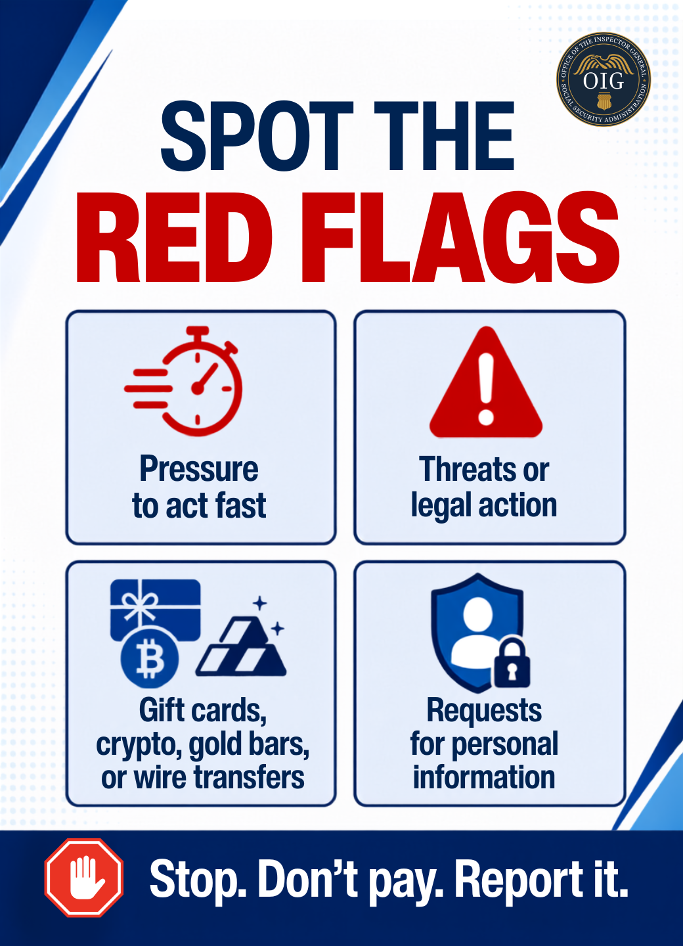
Know the red flags. Scammers may pressure you to act fast, threaten legal action, ask for gift cards or wire transfers, or request personal information. These tactics signal a scam, not a legitimate government contact.
Review the signs at ssa.gov/scam and share this reminder with your network.
#SlamTheScam #ScamAwareness #FraudPrevention

Slide 3
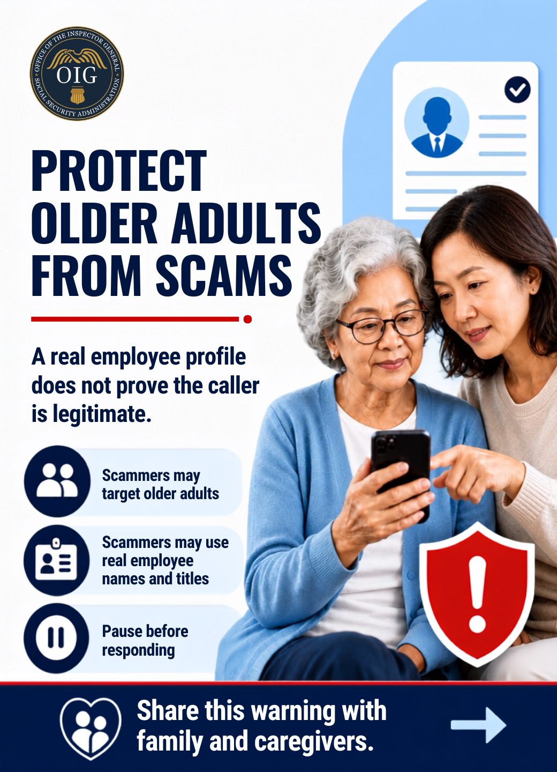
Help protect older adults from scams. A scammer may use a real employee name, title, or public profile to sound credible. Remind family members, caregivers, and community partners that a real profile does not verify the caller.
Share this with family members, caregivers, and older adults in your community. Learn more at ssa.gov/scam.
#SlamTheScam #ScamAwareness #FraudPrevention

Slide 4
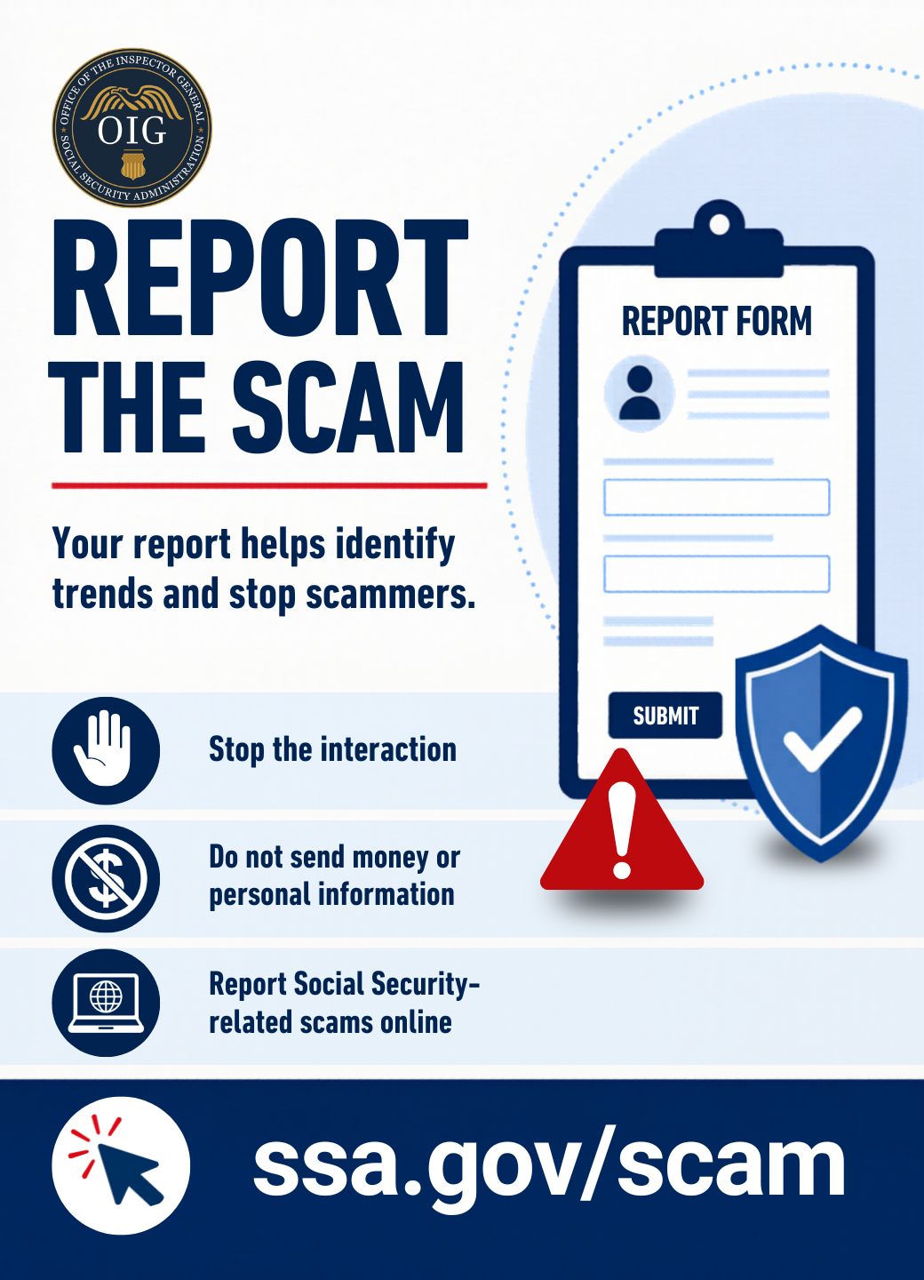
Reporting scams helps identify trends and protect more people. If you receive a suspicious Social Security-related call, email, text, or social media message, stop the interaction, do not send money or personal information, and report it online.
Report Social Security-related scams at ssa.gov/scam.
#SlamTheScam #ScamAwareness #FraudPrevention

