Slide 1
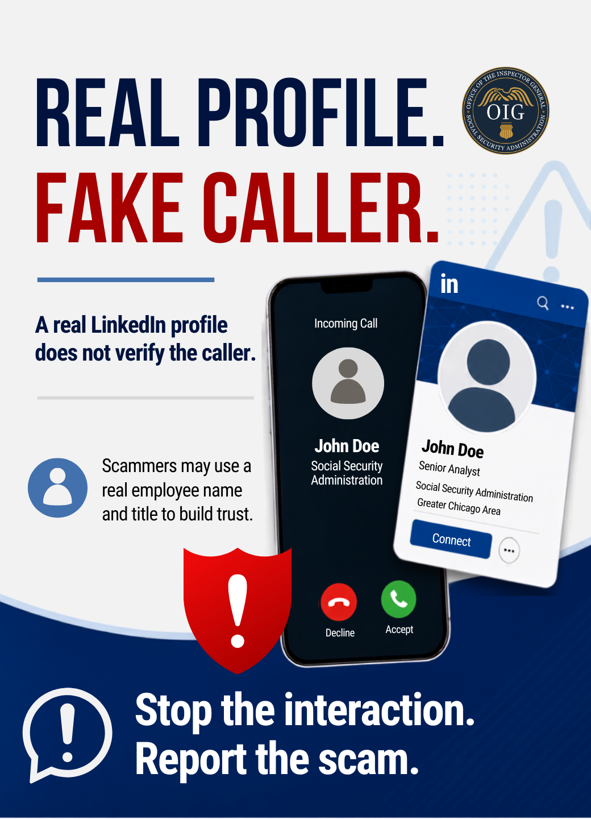
Real profile. Fake caller. A real employee profile does not verify the contact. If someone claims to be from SSA and pressures you or asks for money or personal information, stop and report it.
Save and share this warning. Learn more at ssa.gov/scam.
#SlamTheScam #ScamAwareness #FraudPrevention

Slide 2
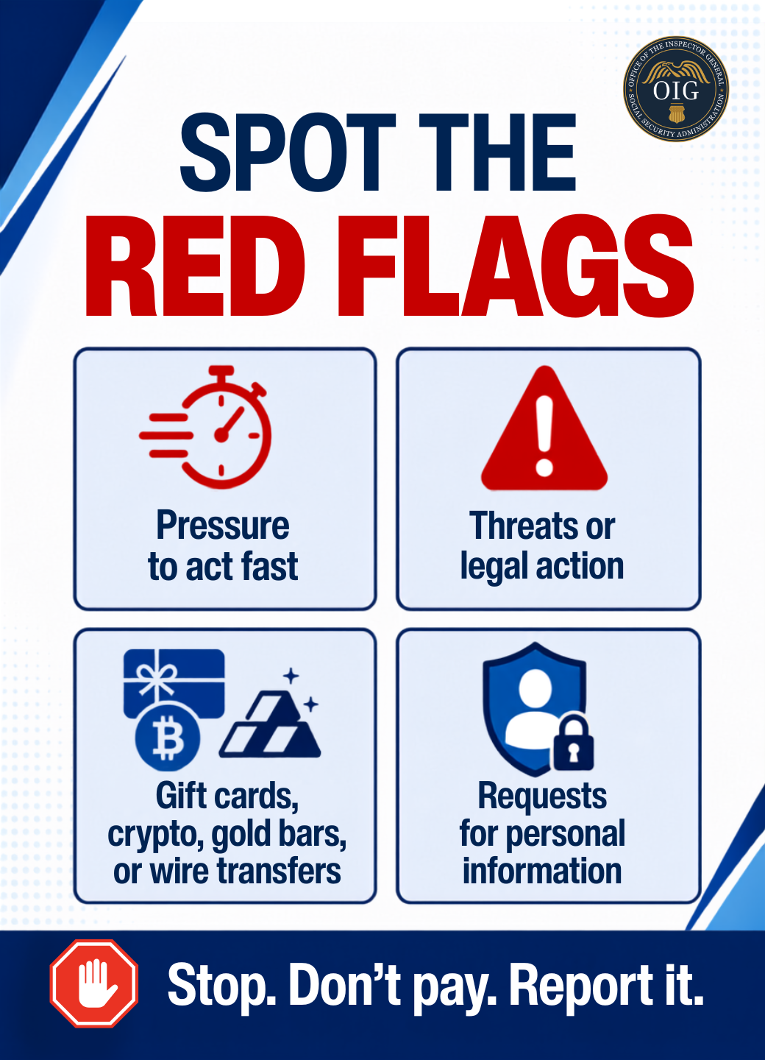
Spot the red flags. Pressure, threats, unusual payment requests, and requests for personal information are warning signs of a scam - not proof of a real government contact.
Save this checklist and share it with friends and family.
#SlamTheScam #ScamAwareness #FraudPrevention

Slide 3
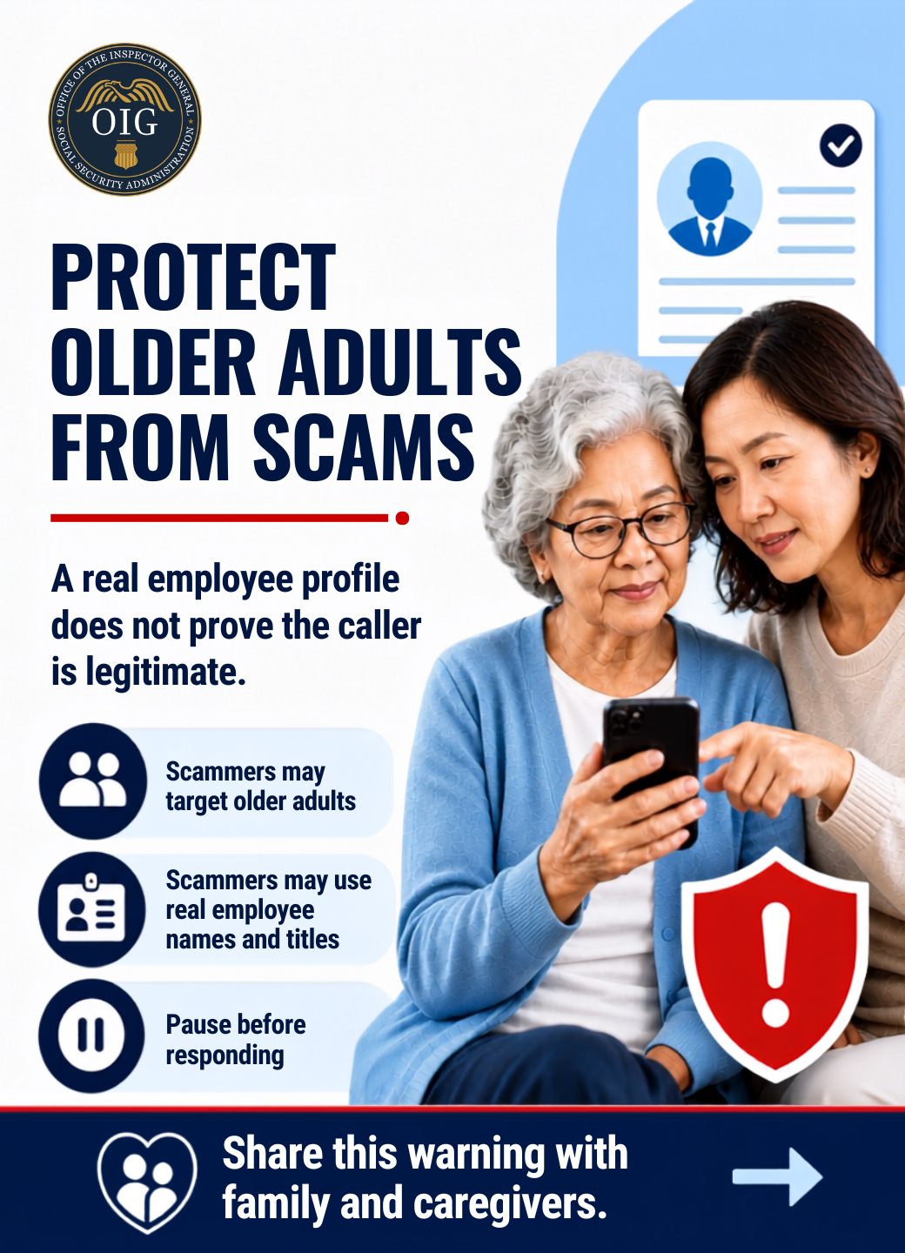
Older adults are especially vulnerable to scams. A scammer may use a real name or profile to build trust. Pause, verify, and never send money or personal information because of pressure or threats.
Save this post and send it to a caregiver or family member.
#SlamTheScam #ScamAwareness #FraudPrevention

Slide 4
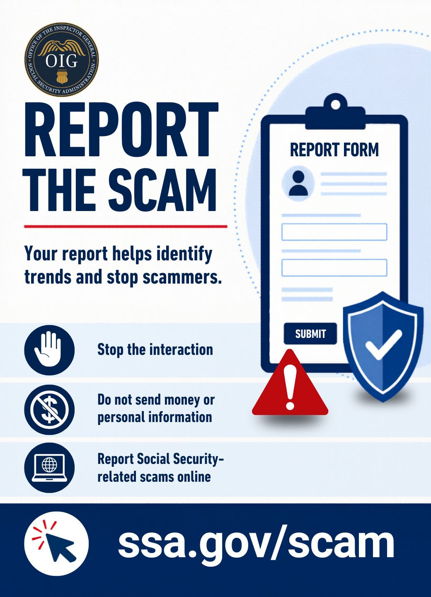
Report the scam. Stop the interaction. Do not send money. Do not share personal information. Report suspicious Social Security-related scams online.
Save this so you know what to do and share it with others.
#SlamTheScam #ScamAwareness #FraudPrevention

